Slide 1
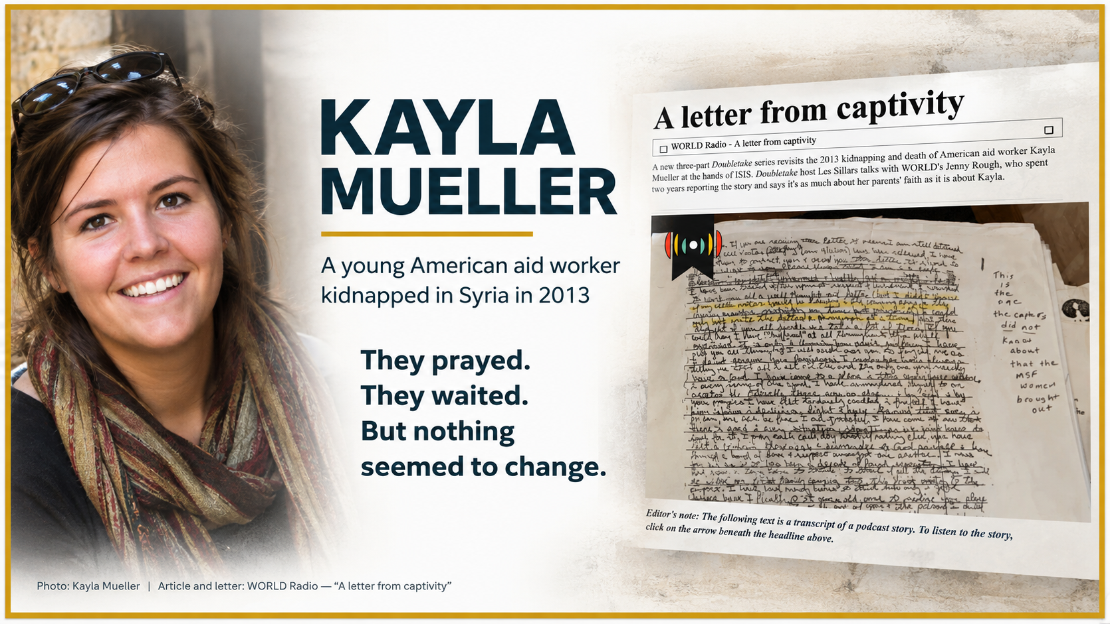
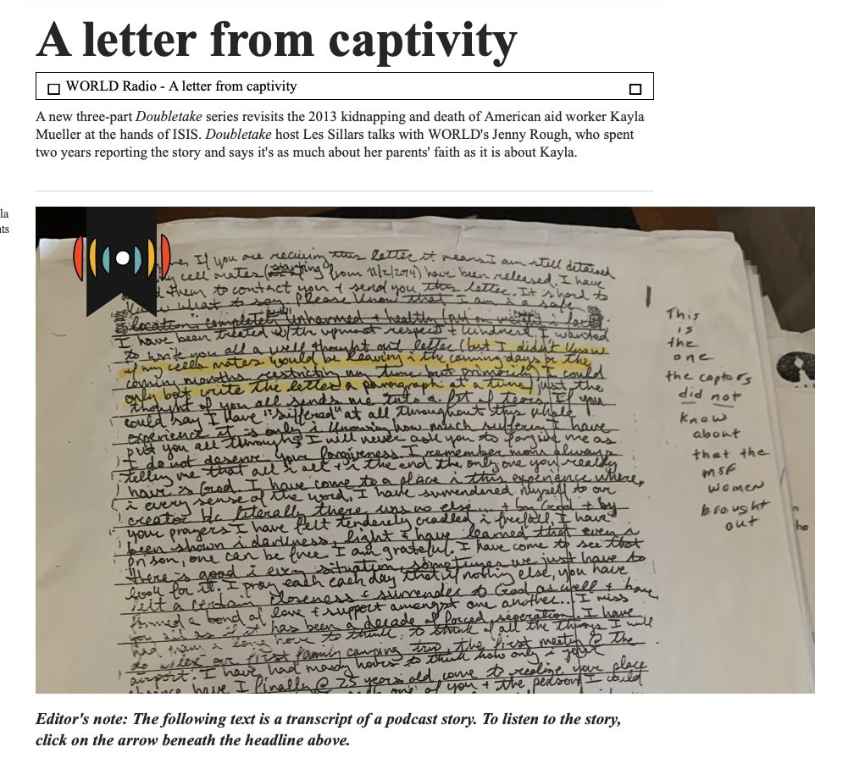
KAYLA MUELLER
A young American aid worker
kidnapped in Syria in 2013
They prayed. They waited.
But nothing seemed to change.
Opening illustration source: WORLD Radio — “A letter from captivity”

Slide 2
WHERE IS GOD IN THIS?
Does he hear?
Does he remember?
Does he see?
Does he know?
Exodus 2:24–25

Slide 3
MAIN POINT
God makes himself known,
and because we know who he is,
we can trust him, obey him,
and make him known.

Slide 4
EXODUS 2:23–25
CSB
23 After a long time, the king of Egypt died. The Israelites groaned because of their difficult labor, and they cried out, and their cry for help because of the difficult labor ascended to God. 24 God heard their groaning, and God remembered his covenant with Abraham, with Isaac, and with Jacob. 25 God saw the Israelites, and God knew.

Slide 5
GOD HAD NOT FORGOTTEN HIS PEOPLE.
God
heard.
God
remembered.
God
saw.
God
knew.
He knew it was time to act.

Slide 6
EXODUS 3:1–6
CSB
1 Meanwhile, Moses was shepherding the flock of his father-in-law Jethro, the priest of Midian. He led the flock to the far side of the wilderness and came to Horeb, the mountain of God. 2 Then the angel of the LORD appeared to him in a flame of fire within a bush. As Moses looked, he saw that the bush was on fire but was not consumed. 3 So Moses thought, “I must go over and look at this remarkable sight. Why isn’t the bush burning up?” 4 When the LORD saw that he had gone over to look, God called out to him from the bush, “Moses, Moses!” “Here I am,” he answered. 5 “Do not come closer,” he said. “Remove the sandals from your feet, for the place where you are standing is holy ground.” 6 Then he continued, “I am the God of your father, the God of Abraham, the God of Isaac, and the God of Jacob.” Moses hid his face because he was afraid to look at God.

Slide 7
EXODUS 3:7–12
CSB
7 Then the LORD said, “I have observed the misery of my people in Egypt, and have heard them crying out because of their oppressors. I know about their sufferings, 8 and I have come down to rescue them from the power of the Egyptians and to bring them from that land to a good and spacious land, a land flowing with milk and honey—the territory of the Canaanites, Hethites, Amorites, Perizzites, Hivites, and Jebusites. 9 So because the Israelites’ cry for help has come to me, and I have also seen the way the Egyptians are oppressing them, 10 therefore, go. I am sending you to Pharaoh so that you may lead my people, the Israelites, out of Egypt.” 11 But Moses asked God, “Who am I that I should go to Pharaoh and that I should bring the Israelites out of Egypt?” 12 He answered, “I will certainly be with you, and this will be the sign to you that I am the one who sent you: when you bring the people out of Egypt, you will all worship God at this mountain.”

Slide 8
WHO AM I?
Exodus 3:11–12
“Who am I?”
“I will certainly be with you.”
“I will never leave you or abandon you.”
Hebrews 13:5
Whatever we’re walking through, we are never alone. Ever.

Slide 9
MOSES’ FIRST CONCERN
Exodus 3:13–15
MOSES
GOD
“Who sent me?”
“I AM WHO I AM.”
God hasn’t changed. He is faithful. He keeps his word.

Slide 10
MOSES’ SECOND CONCERN
Exodus 4:1–9
MOSES
GOD
“What if they
don’t believe me?”
God provides
what Moses needs.
The signs confirm that God appeared to Moses and sent him.

Slide 11
MOSES’ THIRD CONCERN
Exodus 4:10–12
MOSES
GOD
“I can’t speak.”
“Who placed a mouth
on humans?”
We look at what we don’t have. God keeps saying, “Look at me.”

Slide 12
MOSES’ FOURTH CONCERN
Exodus 4:13–17
MOSES
GOD
“Send someone else.”
God is angry,
yet merciful.
Moses is still Moses. But now he knows the God who is sending him.

Slide 13
SOMETHING STRANGE ALONG THE WAY
Exodus 4:24–26
The God who called Moses is holy.
Moses can’t ignore the sign of God’s covenant
in his own family.
Moses is deeply imperfect. Yet God is going to use him.

Slide 14
DON’T MISS HOW THE PASSAGE BEGINS AND ENDS
→
GROANING
WORSHIP
Nothing has changed yet.
They’re still enslaved. Pharaoh is still Pharaoh.
The plagues haven’t happened. The Red Sea hasn’t parted.

Slide 15
CONCLUSION
Exodus 3:8
“I HAVE COME DOWN
TO RESCUE THEM.”
Our greatest bondage isn’t Egypt.
It’s sin and death. And we can’t rescue ourselves.
But Jesus came down to do what we could never do.

Slide 16
OUR RESPONSE
TRUST HIM.
He hears. He remembers. He sees. He knows.
MAKE HIM KNOWN.
Jesus has sent us too.
Everything around you may change, but he does not.

Slide 17
IS GOD ENOUGH?
“And remember, I am with you always,
to the end of the age.”
“I will be with you.”
TRUST HIM. • OBEY HIM. • MAKE HIM KNOWN.

