Slide 1
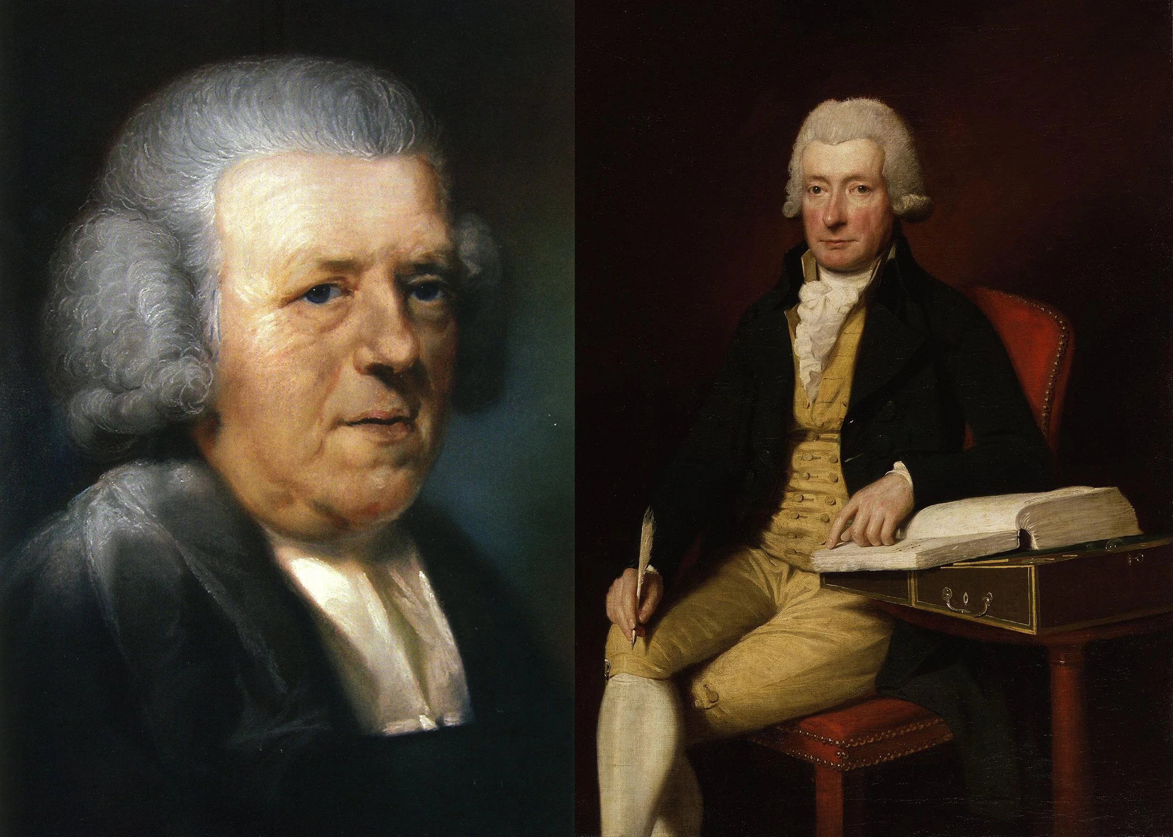
John Newton
and William Cowper

Slide 2
“He was indeed a bush in flames
for 27 years but he was not consumed.
And why? Because the Lord was there.”
John Newton

Slide 3
Hearts bound together by the gospel advance the mission of the gospel.
Colossians 4:7-18

Slide 4
Hearts bound together
by the gospel
Advancing the mission
of the gospel

Slide 5
Christian community is the fruit
of the gospel, not the gospel itself.
The gospel → creates a people, the church.

Slide 6
Characteristics of Christian Fellowship
1.
Christians have a ministry of encouragement to one another.

Slide 7
“I have sent him to you for this very purpose,
so that you may know how we are and so that
he may encourage your hearts.”
Colossians 4:8

Slide 8
“These alone of the circumcision
are my coworkers for the kingdom of God,
and they have been a comfort to me.”
Colossians 4:11

Slide 9
Characteristics of Christian Fellowship
1.
2.
Christians have a ministry of encouragement to one another.
Christians call one another to remain steadfast and faithful in the ministry.

Slide 10
“Pay attention to the ministry
you have received in the Lord,
so that you can accomplish it.”
Colossians 4:17

Slide 11
“because Demas has deserted me,
since he loved this present world,
and has gone to Thessalonica.
Crescens has gone to Galatia,
Titus to Dalmatia.”
2 Timothy 4:10

Slide 12
“Now the one sown among the thorns—
this is one who hears the word,
but the worries of this age and the deceitfulness
of wealth choke the word, and it becomes unfruitful.”
Matthew 13:22

Slide 13
Characteristics of Christian Fellowship
1.
2.
3.
Christians have a ministry of encouragement to one another.
Christians call one another to remain steadfast and faithful in the ministry.
Christians labor in prayer for one another.

Slide 14
“Epaphras, who is one of you,
a servant of Christ Jesus, sends you greetings.
He is always wrestling for you in his prayers,
so that you can stand mature and fully assured
in everything God wills.”
Colossians 4:12

Slide 15
God’s Word builds the church.
The Word does the work.

Slide 16
“After this letter has been read at your gathering
have it read also in the church of the Laodiceans;
and see that you also read the letter from Laodicea.”
Colossians 4:16

Slide 17
CANON
rule or standard
How did we get the Bible?

Slide 18
The church does not give the Bible its authority;
it only recognizes the authority it already has.

Slide 19
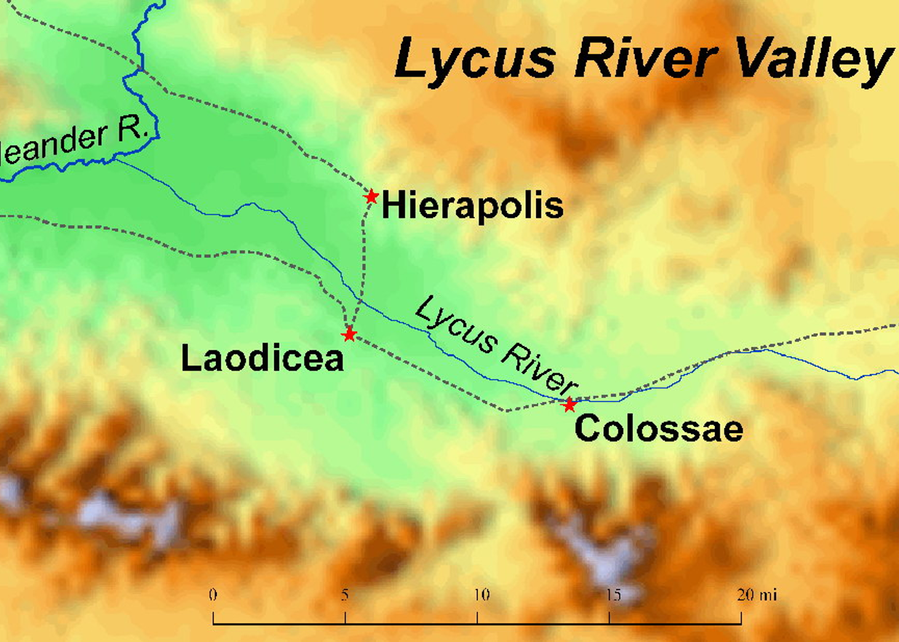
“For I testify about him that he works hard for you,
for those in Laodicea, and for those in Hierapolis.”
Colossians 4:13

Slide 20




Slide 21
“I, Paul, am writing this greeting with my own hand. Remember my chains. Grace be with you.
Colossians 4:18

