Slide 1
Colossians 1:24-29

Slide 2


Slide 3
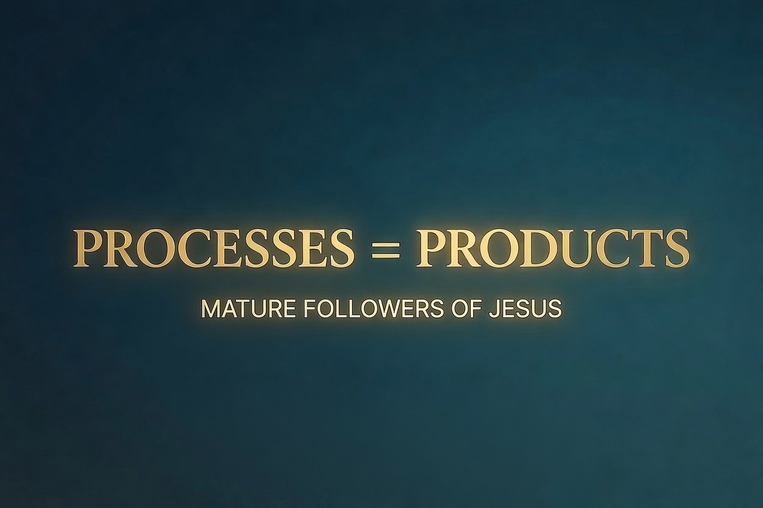

Slide 4


Slide 5
1:24-25 Now I rejoice in what was suffered for you, and I fill up in my flesh what is still lacking in regard to Christ’s afflictions, for the sake of his body, which is the church. I have become its servant by the commission God gave me to present to you the word of God in its fullness

Slide 6
1:26 the mystery that has been kept hidden for ages and generations, but is now disclosed to the saints.

Slide 7
1:27 To them God has chosen to make known among the Gentiles the glorious riches of this mystery, which is Christ in you, the hope of glory.

Slide 8
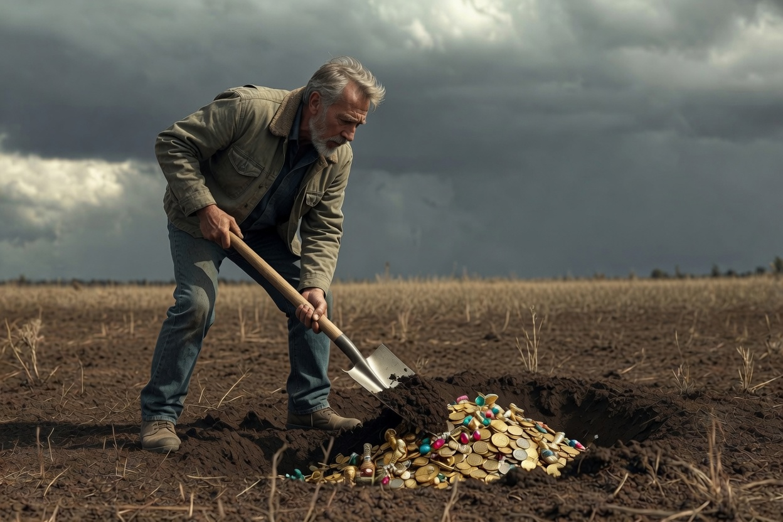
Matthew 13:34

Slide 9
1:28-29 We proclaim him, admonishing and teaching everyone with all wisdom, so that we may present everyone perfect (fully mature) in Christ. To this end I labor, struggling with all his energy, which so powerfully works in me.

Slide 10
1. It is about Jesus
2. It includes admonishing and teaching
3. The goal is full Christlike maturity
4. It takes gritty effort and God’s grace

Slide 11
According to the stewardship from God that was given to me for you.

Slide 12
Barriers
1. The imposter syndrome
2. A failure of imagination

Slide 13
1:28-29 We proclaim him, admonishing and teaching everyone with all wisdom, so that we may present everyone perfect in Christ. To this end I labor, struggling with all his energy, which so powerfully works in me.

Slide 14
Then I heard the voice of the Lord saying, “Whom shall I send? And who will go for us?”
And I said, “Here am I. Send me!”
Isaiah 6:8

