Slide 1
Parent, Church, Child Dedication

Slide 2
Three Challenges
Fear the Lord
Throw away idols
Choose today

Slide 3


Slide 4
From resources to stewardship

Slide 5
In the presence of God and of Christ Jesus, who will judge the living and the dead, and in view of his appearing and his kingdom, I give you this charge.

Slide 6
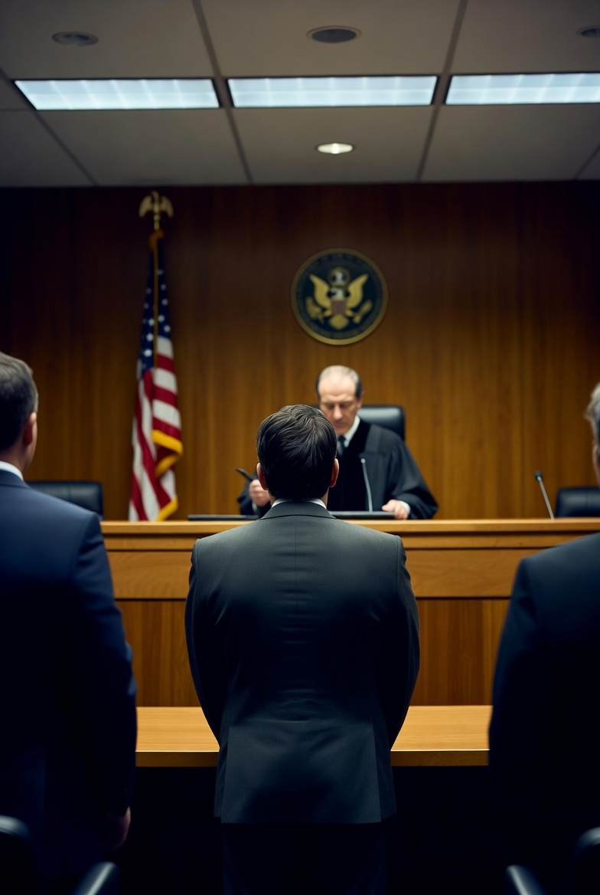
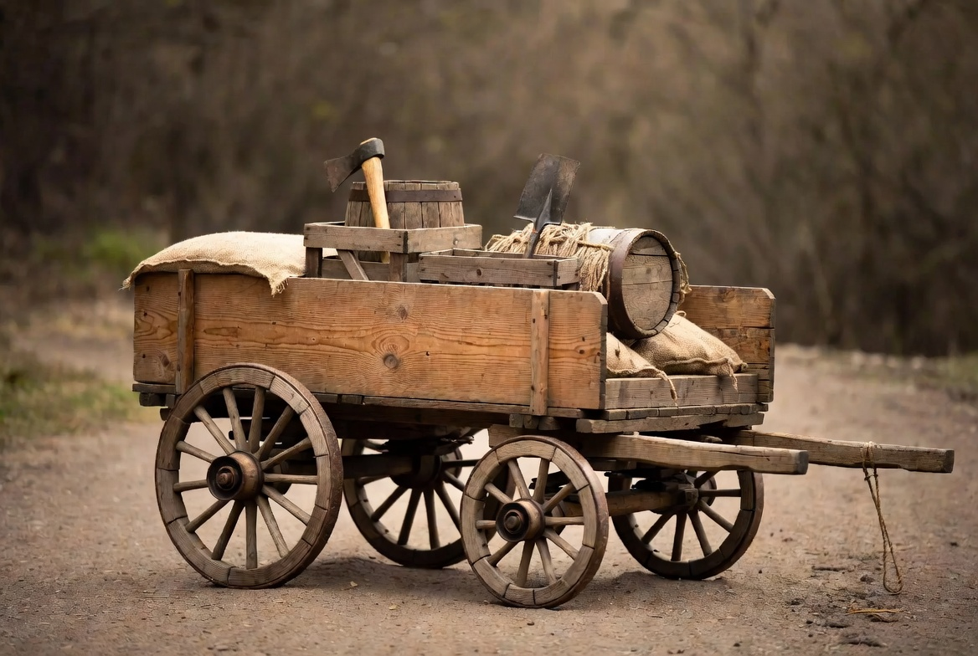
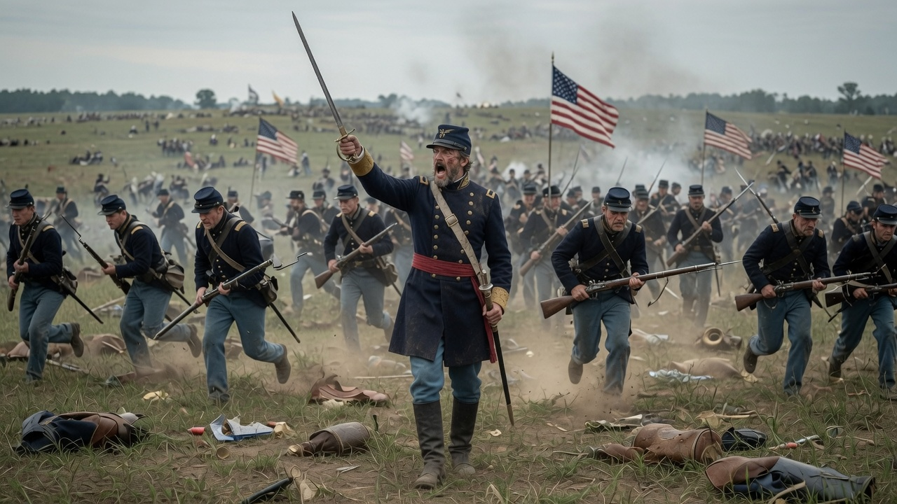
Charge

Slide 7
A serious declaration of responsibility with real life implications.

Slide 8
In the presence of God and of Christ Jesus, who will judge the living and the dead, and in view of his appearing and his kingdom, I give you this charge.

Slide 9
Preach the Word!

Slide 10
Be prepared in season and out of season

Slide 11
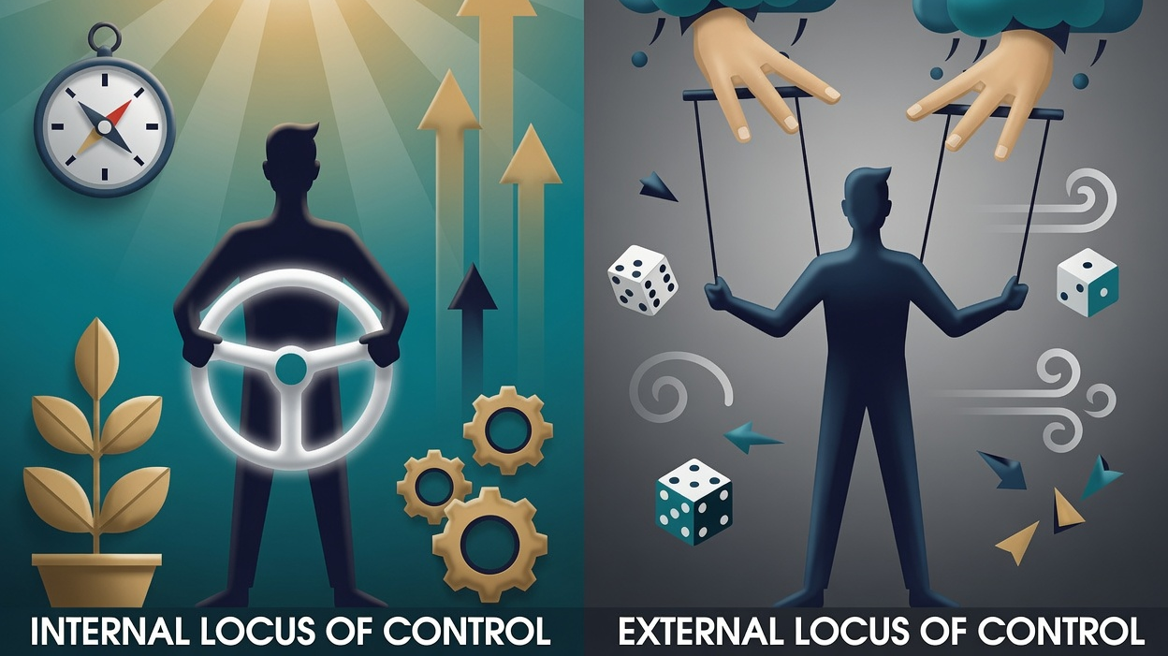

Slide 12
Be prepared in season and out of season

Slide 13

Correct

Slide 14
Rebuke
Beliefs Become Behavior

Slide 15
Encourage
For everything that was written in the past was written to teach
us, so that through the endurance and the encouragement of the
Scriptures we might have hope.
Romans 15:4

Slide 16
With great patience and careful instruction

Slide 17
For the time will come when men will not put up with sound doctrine. Instead, to suit their own desires, they will gather around them a great number of teachers to say what their itching ears want to hear.

Slide 18
But you, keep your head in all situations, endure hardship, do the work of an evangelist, discharge all the duties of your ministry.

Slide 19
Keep your head=Don’t Freak Out!

Slide 20
Endure Hardship
Do the work of evangelism
Discharge all the duties of your ministry

Slide 21
What pastors are to lead in,
the church is to follow in.

Slide 22
Poured out like a drink offering
Fought the good fight
Finished the race
Kept the faith

