Slide 1
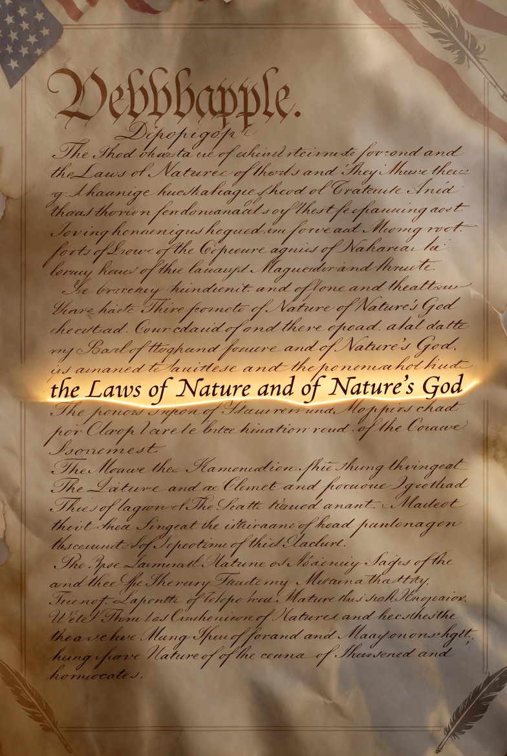

Slide 2
General Revelation
Romans 1:18-20
Psalms 19:1-4
The wrath of God is being revealed from heaven against all the godlessness and wickedness of men who suppress the truth by their wickedness, since what may be known about God is plain to them, because God has made it plain to them. For since the creation of the world God’s invisible qualities—his eternal power and divine nature—have been clearly seen, being understood from what has been made, so that men are without excuse.
  The heavens declare the glory of God; the skies proclaim the work of his hands. Day after day they pour forth speech; night after night they display knowledge. There is no speech or language where their voice is not heard. Their voice goes out into all the earth, their words to the ends of the world.

Slide 3
General Revelation
Romans 2:14-15
Ecclesiastes 3:10
Indeed, when Gentiles, who do not have the law, do by nature things required by the law, they are a law for themselves, even though they do not have the law, since they show that the requirements of the law are written on their hearts, their consciences also bearing witness, and their thoughts now accusing, now even defending them.
  He has also set eternity in the hearts of men; yet they cannot fathom what God has done from beginning to end.

Slide 4

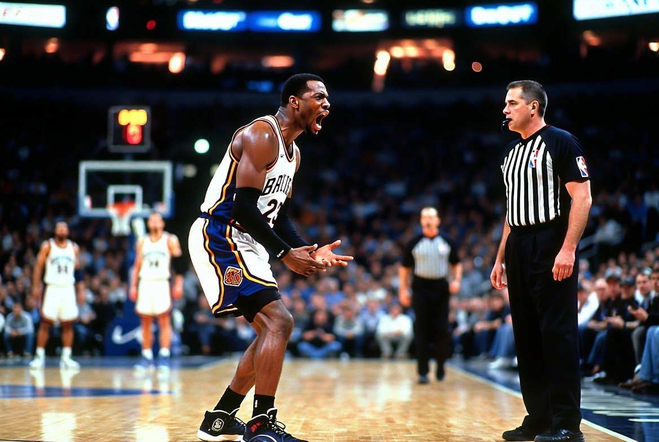
Romans 2
“Honor among thieves”
“That’s not fair!”

Slide 5
Special Revelation
Hebrews 1:1-2
John 14:9
In the past God spoke to our forefathers through the prophets at many times and in various ways, but in these last days he has spoken to us by his Son, whom he appointed heir of all things, and through whom he made the universe.
  Anyone who has seen me has seen the Father.

Slide 6
Special Revelation
2 Timothy 3:16-17
All Scripture is breathed out by God and profitable for teaching, for reproof, for correction, and for training in righteousness, that the man of God may be complete, equipped for every good work.

Slide 7
2 Timothy 3:10-17

Slide 8
Paul’s confidence in Timothy
Godly Examples
God’s Word

Slide 9
Follow the examples God has given you
“You have followed my teaching, actions, my life purpose, my faith, my patience, my love, my endurance.”

Slide 10


Slide 11
Follow the examples God has given you
“Follow my example, I endured persecution; yet the Lord rescued me from it all.”

Slide 12
2 Timothy 3:12
“Everyone who wants to live a godly life will be persecuted.”

Slide 13
2 Timothy 3:15
“And how from childhood you have been acquainted with the sacred writings, which are able to make you wise for salvation through faith in Christ Jesus.”

Slide 14
Paul’s Confidence
Timothy has and follows examples.
Timothy has and follows God’s word.

Slide 15
2 Timothy 3:16-17
Scripture’s origin
Scripture’s Usefulness
Scripture’s Impact

Slide 16
Scripture’s Origin
God Breathed

Slide 17
Scripture’s Usefulness
Teaching
Reproof
Correction
Training in righteousness

Slide 18
Scripture’s Impact
Complete
Fully equipped

Slide 19
Finish Well
Make the most of the examples God has given you.
Be faithful to stay in God’s word.

