Slide 1
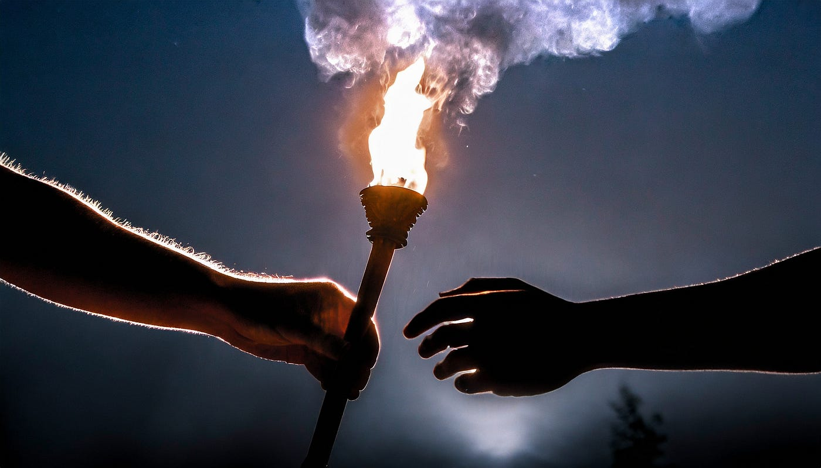
Turn to 2 Timothy 1:1-7

Slide 2
Suffering is one of the main themes of 2 Timothy. Suffering is a real thing that affects real people in real ways.

Slide 3
1. Reminds Him of reasons for confidence 2. Reminds Him to Fan Into Flame 3. Reminds Him of the Spirit that Indwells
2 Timothy 1:1-7 Paul strengthens Timothy’s confidence with 3 reminders.

Slide 4
Remind Him for Reasons for Confidence (2 reasons)
We serve the same Lord
I am an apostle of Jesus, by God’s will.

Slide 5
Remind Him for Reasons for Confidence (2 reasons)
We serve the same Lord
I am an apostle of Jesus, by God’s will.
Grace, mercy, and peace to you from God the Father and Christ Jesus OUR LORD

Slide 6
Remind Him for Reasons for Confidence (2 reasons)
2. A Spiritual Heritage
I thank God, whom I serve with a clear conscience as my ancestors did, when I constantly remember you in my prayers night and day. 4 Remembering your tears, I long to see you so that I may be filled with joy.
I recall your sincere faith that first lived in your grandmother Lois and in your mother Eunice and now, I am convinced, is in you also.

Slide 7

There would be no Timothy without Lois and Eunice

Slide 8
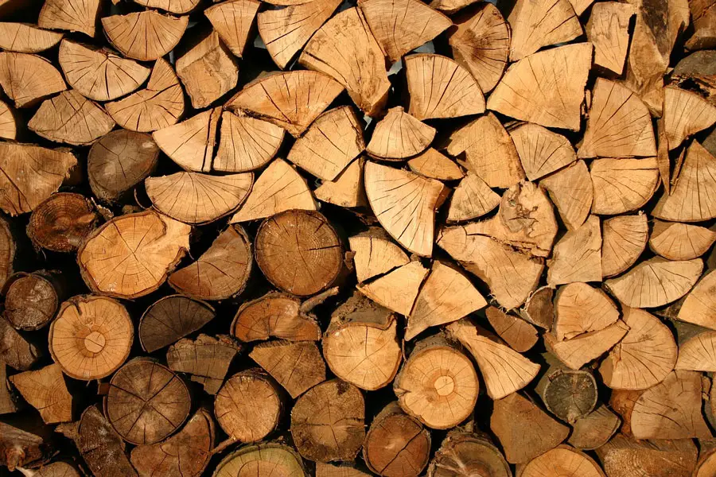
You are NOT responsible to light the fire of faith in the lives of your children, that is an act of grace, but you can stack the wood. God may light the fire.

Slide 9
And my God will meet all your needs according to his abundant riches in Christ Jesus. Phil 4:19

Slide 10
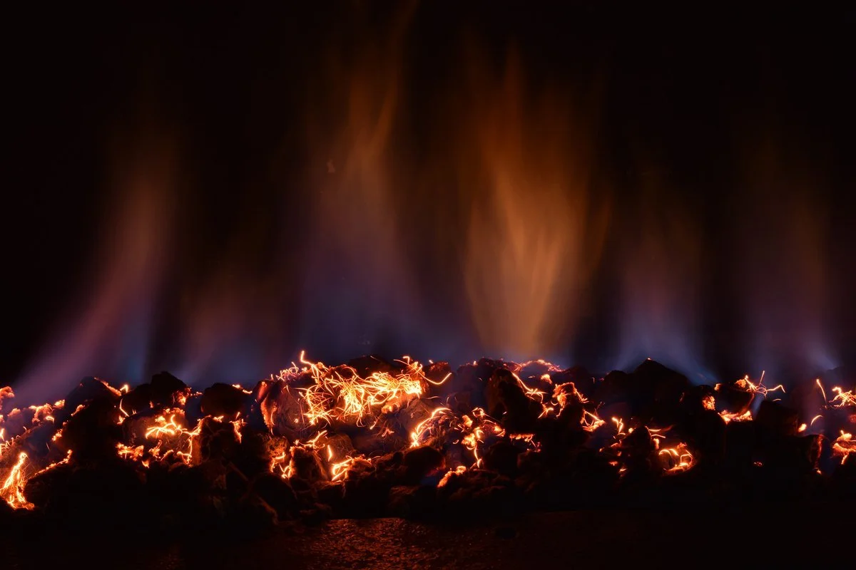
Reminder to Fan into flame the gift of God.
Verse 6 - For this reason, I remind you to fan into flame the gift of God, which is in you through the laying on of my hands.

Slide 11
There is no replacement for the daily fuel that we find when we feast on God’s word.

Slide 12
Preach the Gospel to Yourself
Ephesians 2:1-10

Slide 13
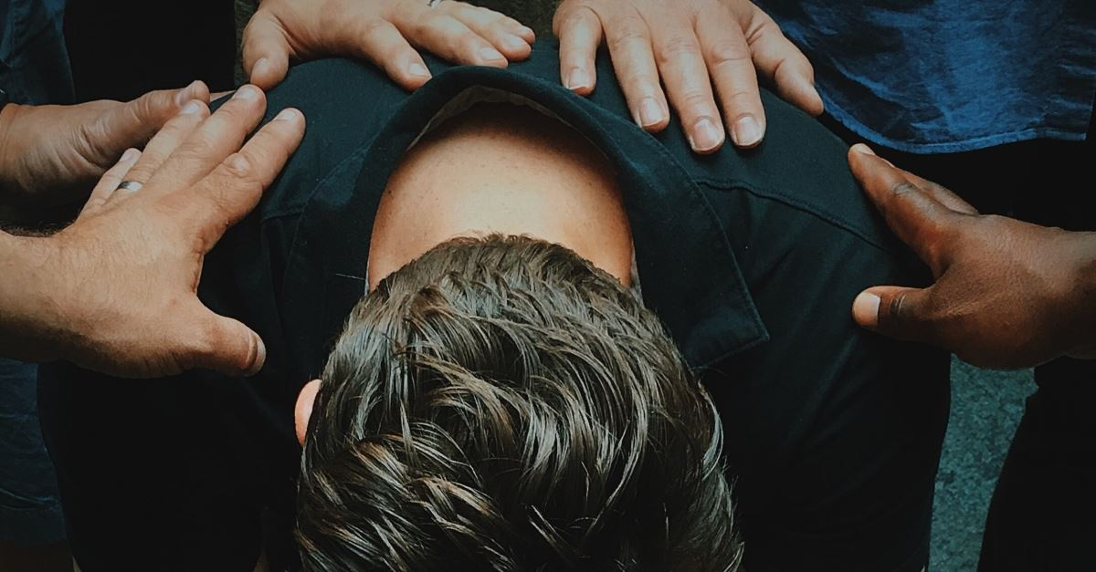
Bring to Mind Spiritual Markers
We don’t recall the past to relive the past, we recall the past to refuel for the present.

Slide 14
Reminder of the Spirit that Indwells Him
Verse 7 God has not given US a spirit of fear, but of power, love, and self-discipline.
Paul is not calling Timothy to self-reliance but God reliance.

Slide 15
Power + love = relationships
Power + self-discipline = endure
Love + power = action
Love + self-discipline = sacrifice
Love
Self-Discipline
Power

Slide 16
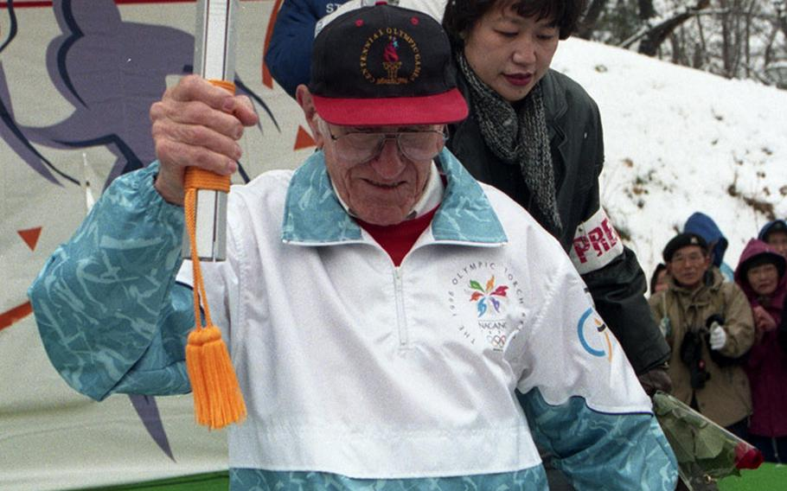

Slide 17
The tears of hardship can blur our vision to the reality of God’s provision and faithfulness.

Slide 18
4 Questions
Even during hardship, who are you spurring on?
Who can give an outside perspective to the hardship of your life?
When this person with an outside perspective speaks, do you believe them?
Is the flame of your faith faltering?

Slide 19
Matthew 12:20 A bruised reed he will not break, and a smoldering wick he will not snuff out, till he has brought justice through to victory. He is strong and kind. He is Tender and Tenacious

