Slide 1
Give and Guard

Slide 2
¹⁷ As for the rich in this present age, charge them not to be haughty, nor to set their hopes on the uncertainty of riches, but on God, who richly provides us with everything to enjoy. ¹⁸ They are to do good, to be rich in good works, to be generous and ready to share, ¹⁹ thus storing up treasure for themselves as a good foundation for the future, so that they may take hold of that which is truly life.
²⁰ O Timothy, guard the deposit entrusted to you. Avoid the irreverent babble and contradictions of what is falsely called “knowledge,” ²¹ for by professing it some have swerved from the faith.
Grace be with you.
1 Timothy 6:17-21

Slide 3
Give
¹⁷ As for the rich in this present age…
Billions of people on earth live on under $7/day

Slide 4
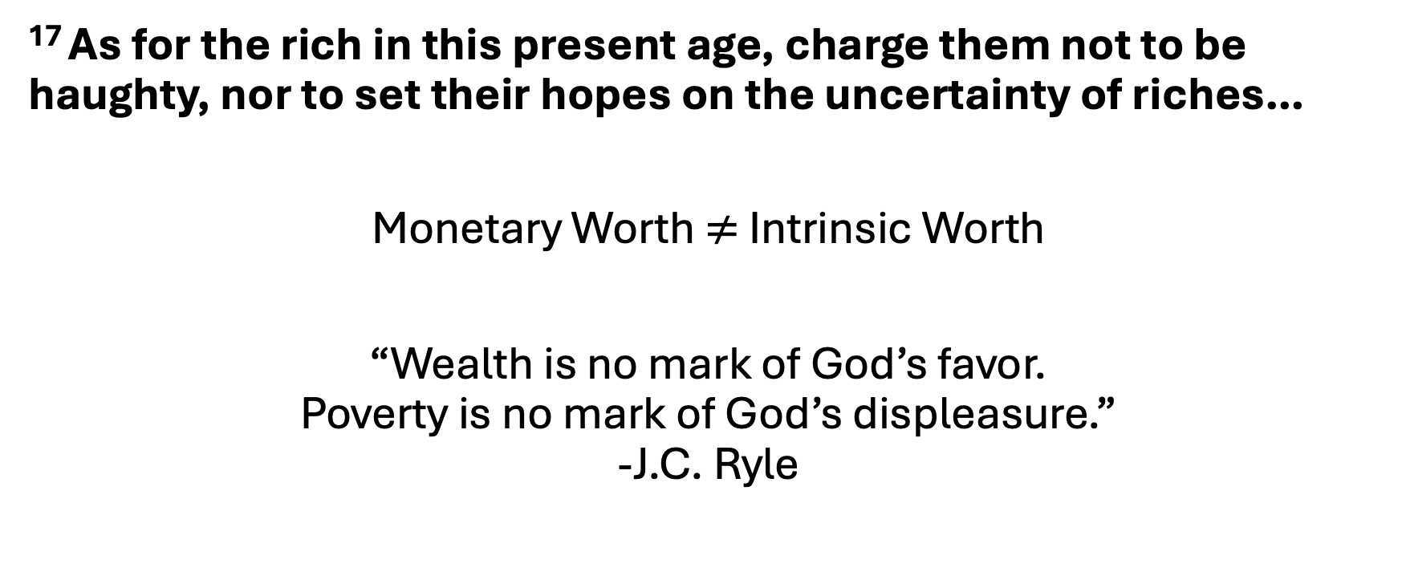
Give
¹⁷ As for the rich in this present age, charge them not to be haughty, nor to set their hopes on the uncertainty of riches…
Monetary Worth $≠$ Intrinsic Worth
“Wealth is no mark of God’s favor.
Poverty is no mark of God’s displeasure.”
-J.C. Ryle

Slide 5
Give
¹⁷ As for the rich in this present age, charge them not to be haughty, nor to set their hopes on the uncertainty of riches…
⁴ Do not toil to acquire wealth; be discerning enough to desist. ⁵ When your eyes light on it, it is gone, for suddenly it sprouts wings, flying like an eagle toward heaven. (Prov. 23:4-5)

Slide 6
Give
¹⁷ As for the rich in this present age, charge them not to be haughty, nor to set their hopes on the uncertainty of riches, but on God, who richly provides us with everything to enjoy.
Christ Jesus is the one firm foundation in a world full of fake ones
Christ, Himself, is our riches

Slide 7
Give
¹⁷ As for the rich in this present age, charge them not to be haughty, nor to set their hopes on the uncertainty of riches, but on God, who richly provides us with everything to enjoy. ¹⁸ They are to do good, to be rich in good works, to be generous and ready to share, ¹⁹ thus storing up treasure for themselves as a good foundation for the future, so that they may take hold of that which is truly life.
Generosity of heart and hand

Slide 8
Guard
²⁰ O Timothy, guard the deposit entrusted to you. Avoid the irreverent babble and contradictions of what is falsely called “knowledge,” ²¹ for by professing it some have swerved from the faith.
Grace be with you.

Slide 9
Guard
²⁰ O Timothy, guard the deposit entrusted to you. Avoid the irreverent babble and contradictions of what is falsely called “knowledge,” ²¹ for by professing it some have swerved from the faith.
Grace be with you.
In much that Paul writes, the church as a whole
is to mimic what the pastor models.

Slide 10
Guard
“make disciples of all nations, baptizing them in the name of the Father and of the Son and of the Holy Spirit, teaching them to observe all that I have commanded you.”
Matt. 28:18-20
Anyone who takes seriously the call to make disciples will, at some time and in some way, need to “guard” the truth.

Slide 11
Give and Guard
Soft Hearts and Stiff Minds

