Slide 1
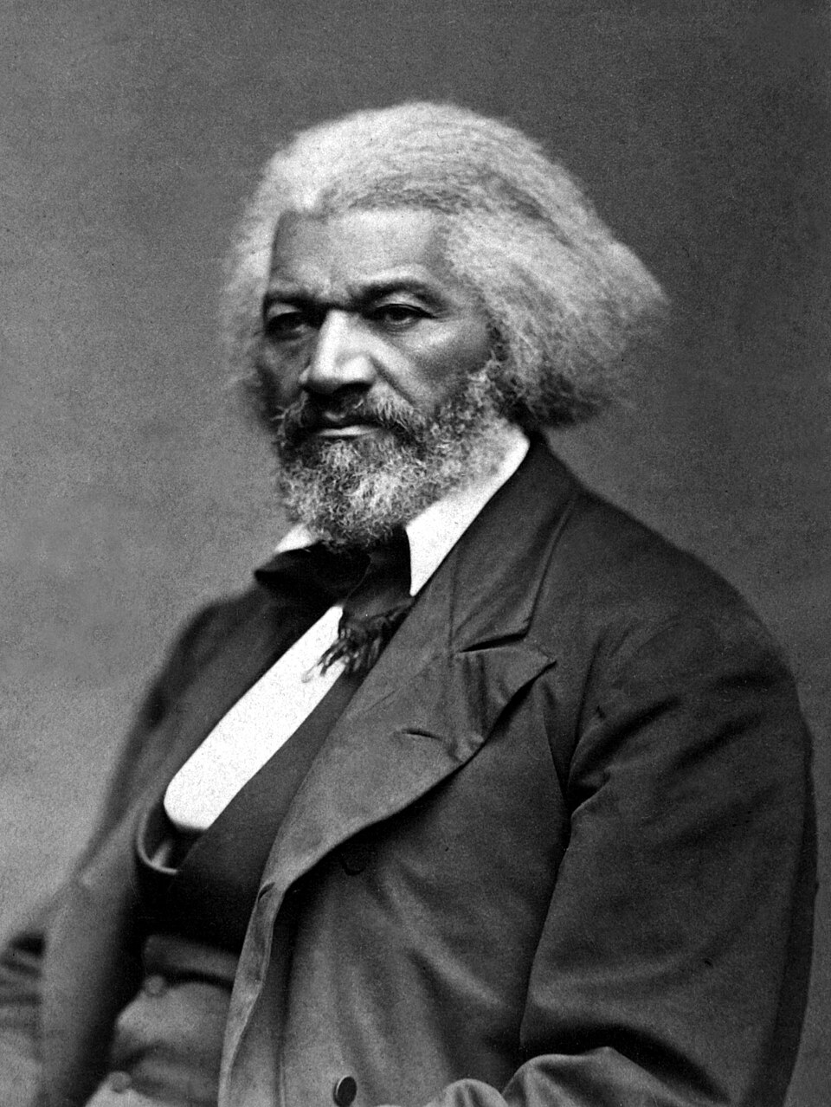
Fredrick Douglass
“Between the Christianity of this land and the Christianity of Christ,
I recognize the
widest possible difference…”

Slide 2
Structural evil, like slavery, is at times allowed in scripture as God accomplishes his greater good.
Jospeh speaking to his brothers who sold him into slavery.
“You intended to harm me, but God intended it for good to accomplish what is now being done, the saving of many lives.” Genesis 50:20

Slide 3
The Bible Does NOT Condone Slavery

Slide 4
If Jesus is your master, then your life under Jesus should impact the way you relate to your earthly master.

Slide 5
1 Timothy 6:1-2
All who are under the yoke as slaves should regard their own masters as worthy of all respect, so that God’s name and his teaching will not be blasphemed. 2 Let those who have believing masters not be disrespectful to them because they are brothers, but serve them even better, since those who benefit from their service are believers and dearly loved.

Slide 6

Slaves in the 1st Century were farm workers, semi-skilled workers but also artisans, architects, physicians, philosophers, writers, and teachers.

Slide 7
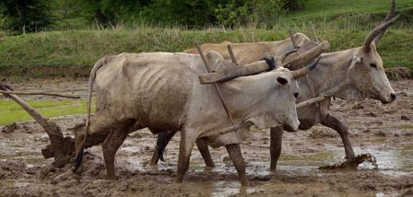
1. Awareness – “Slaves, I see you!”
Your job does not dignify you, you bring dignity to your job

Slide 8
1. Awareness – “Slaves, I see you!”
“All who are under the yoke of slavery”

Slide 9

Your job does not dignify you, you bring dignity to your job.

Slide 10

2. Mandate – Respect your earthly masters
“ALL who are under the yoke should regard their own masters as worthy of ALL respect."
All slaves
All masters
Slaves with competent masters
Slaves with incompetent masters

Slide 11
2. Mandate – Respect your earthly masters
Our training for godliness extends to every sphere of our life. There is no sphere of your life that is not touched by your allegiance to Jesus.

Slide 12
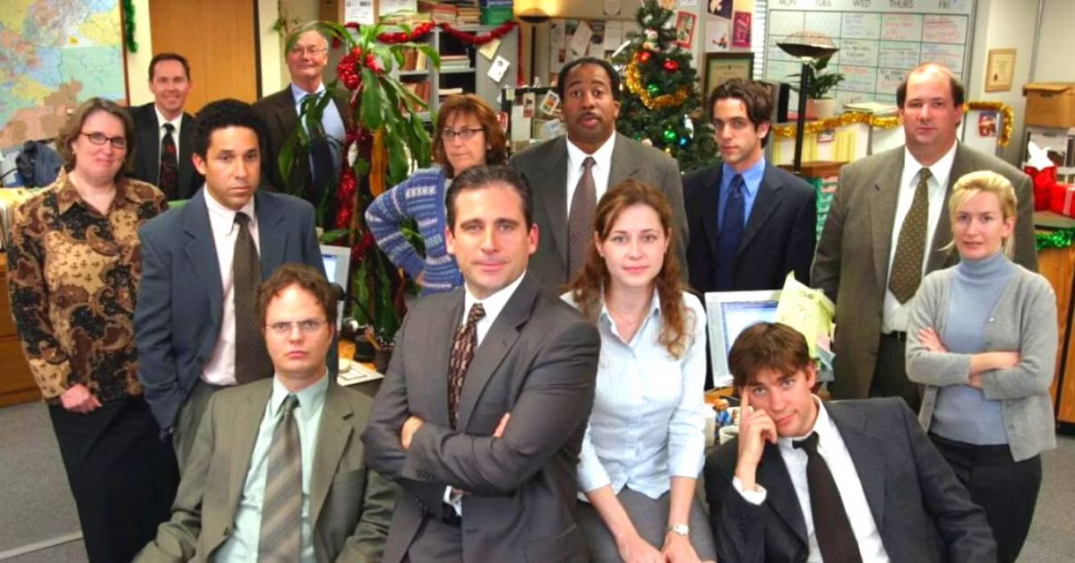
How do you think about those in authority over you?

Slide 13
3. Motivation – Honor God’s Name and His Teaching
God’s name is representative of his full being, his authority, and majesty.
When you honor your boss, you are honoring God.

Slide 14
3. Motivation – Honor God’s Name and His Teaching
God’s name is representative of his full being, his authority, and majesty.
When you honor your boss, you are honoring God.
Be a credible witness of the gospel

Slide 15
Colossians 3:22-24
Slaves, obey your earthly masters in everything; and do it, not only when their eye is on you and to curry their favor, but with sincerity of heart and reverence for the Lord. 23 Whatever you do, work at it with all your heart, as working for the Lord, not for human masters, 24 since you know that you will receive an inheritance from the Lord as a reward. It is the Lord Christ you are serving.

Slide 16
Fredrick Douglass
“Between the Christianity of this land and the Christianity of Christ,
I recognize the
widest possible difference…”

