Slide 1
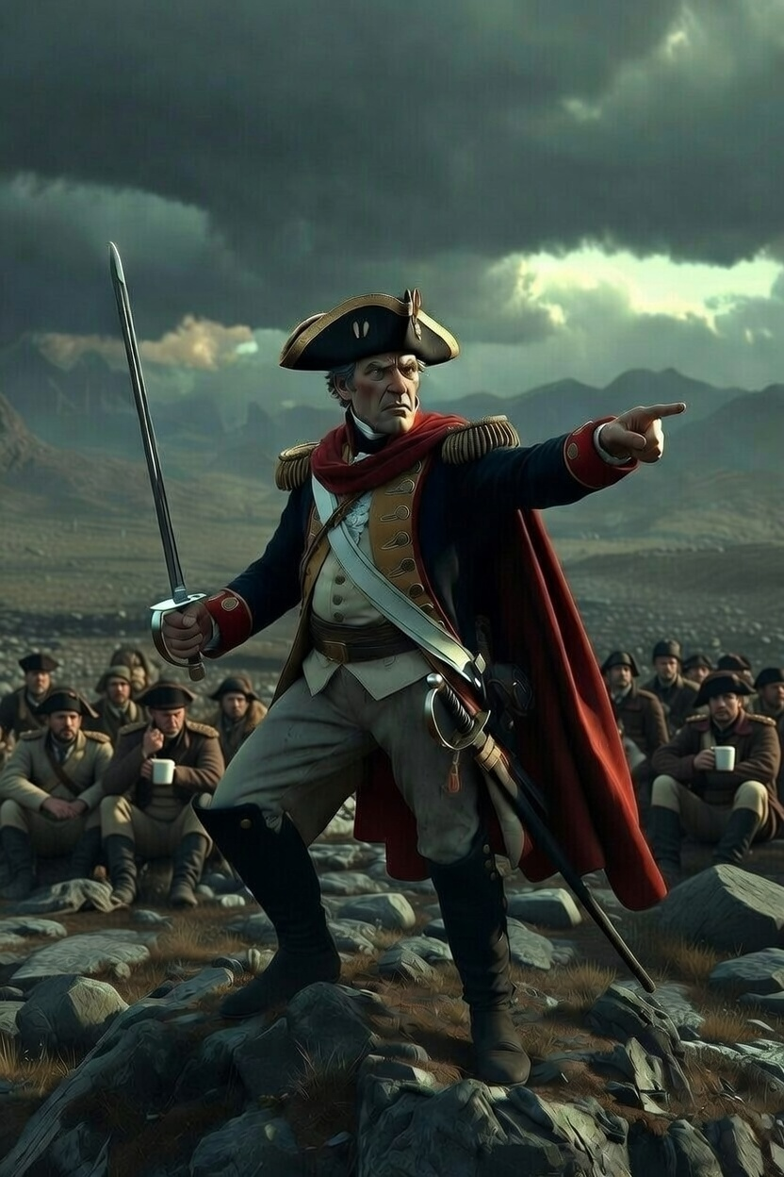
Leadership?

Slide 2

Leadership is going to happen.

Slide 3
“Timothy, make sure good leadership happens.”
1 Timothy 3:1-13

Slide 4
Here is a trustworthy saying: If anyone sets his heart on being an overseer, he desires a noble task.

Slide 5
Acts 20
Elder, Pastor(shepherd), Overseer

Slide 6
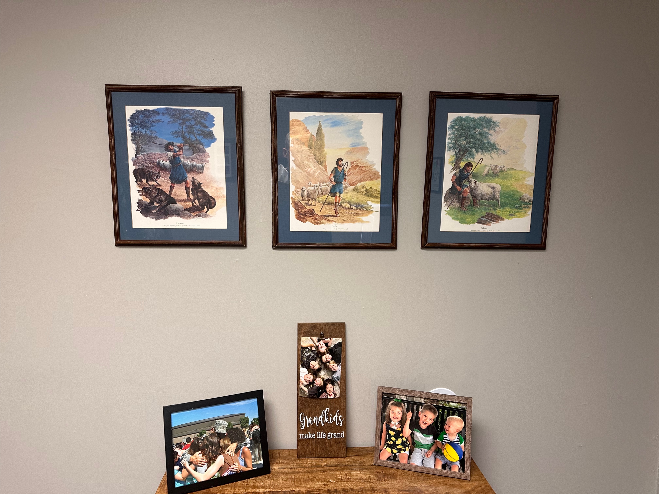

Slide 7
Jesus is the Shepherd and Overseer of your souls.
1 Peter 2:25

Slide 8
A representative not an exhaustive list.

Slide 9
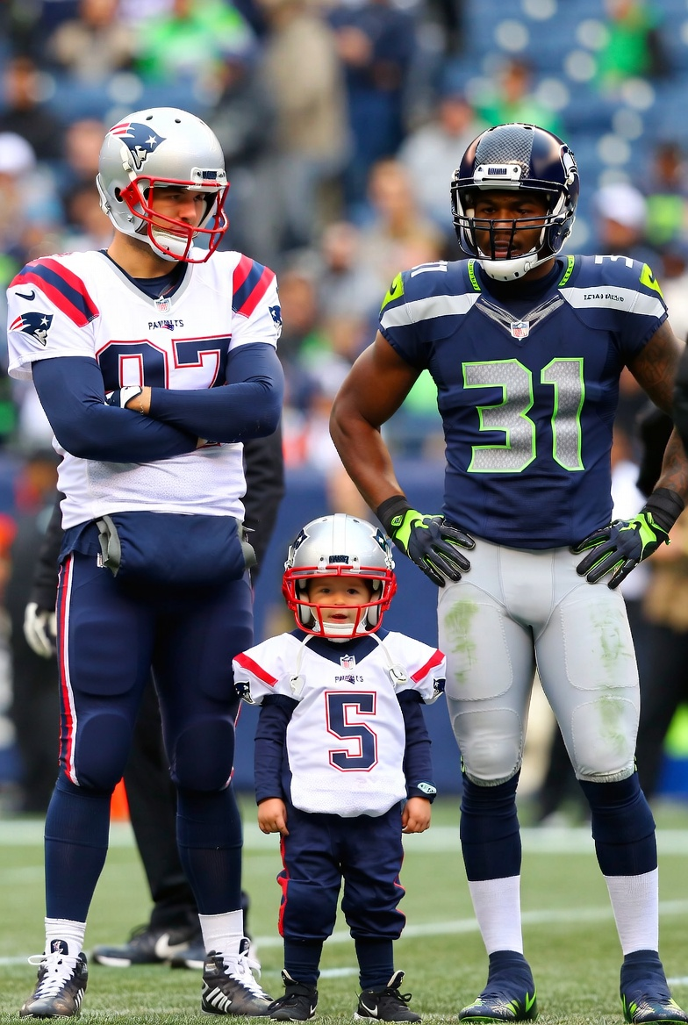
Same basic rules

Slide 10
Now the overseer must be above reproach, the husband of but one wife, temperate, self-controlled, respectable, hospitable, able to teach, not given to drunkenness, not violent but gentle, not quarrelsome, not a lover of money.

Slide 11
The elders who direct the affairs of the church well are worthy of double honor, especially those whose work is preaching and teaching.
1 Tim. 5:17

Slide 12
Now the overseer must be above reproach, the husband of but one wife, temperate, self-controlled, respectable, hospitable, able to teach, not given to drunkenness, not violent but gentle, not quarrelsome, not a lover of money.

Slide 13
What is required of all Christian leaders should be desired by all Christ followers.

Slide 14
Now the overseer must be above reproach, the husband of but one wife, temperate, self-controlled, respectable, hospitable, able to teach, not given to drunkenness, not violent but gentle, not quarrelsome, not a lover of money.

Slide 15
For the love of money is a root of all kinds of evil. Some people, eager for money, have wandered from the faith and pierced themselves with many griefs.
1 Tim. 6:10

Slide 16
He must manage his own family well and see that his children obey him with proper respect. (If anyone does not know how to manage his own family, how can he take care of God’s church?)

Slide 17
He must not be a recent convert, or he may become conceited and fall under the same judgment as the devil.

Slide 18
He must also have a good reputation with outsiders, so that he will not fall into disgrace and into the devil’s trap.

Slide 19
Deacons, likewise, are to be men worthy of respect, sincere, not indulging in much wine, and not pursuing dishonest gain. They must keep hold of the deep truths of the faith with a clear conscience. They must first be tested; and then if there is nothing against them, let them serve as deacons. In the same way, their wives are to be women worthy of respect, not malicious talkers but temperate and trustworthy in everything. A deacon must be the husband of but one wife and must manage his children and his household well. Those who have served well gain an excellent standing and great assurance in their faith in Christ Jesus.

Slide 20
I commend to you our sister Phoebe, who is a servant (deacon) of the church in Cenchreae. So you should welcome her in the Lord in a manner worthy of the saints and assist her in whatever matter she may require your help. For indeed she has been a benefactor of many—and of me also.
Romans 16:1,2

Slide 21
1. A senior elder/pastor

Slide 22
1. A senior elder/pastor
2. Multiple elders

Slide 23
1. A senior elder/pastor
2. Multiple elders
3. Group leaders operate as “deacons”

Slide 24
1. Lead yourself
(self-control)
2. Seek to earn leadership in the lives of others (influence)

Slide 25

Tension=Balance

Slide 26

The Immune System of the Church

