Slide 1
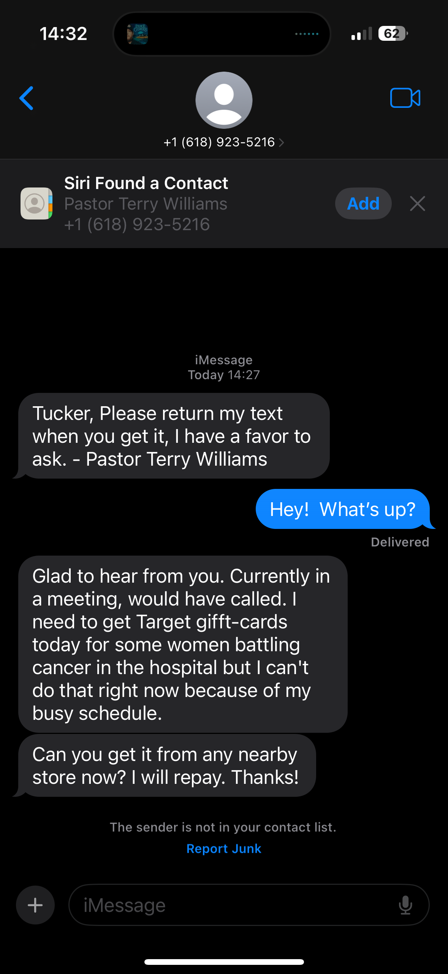
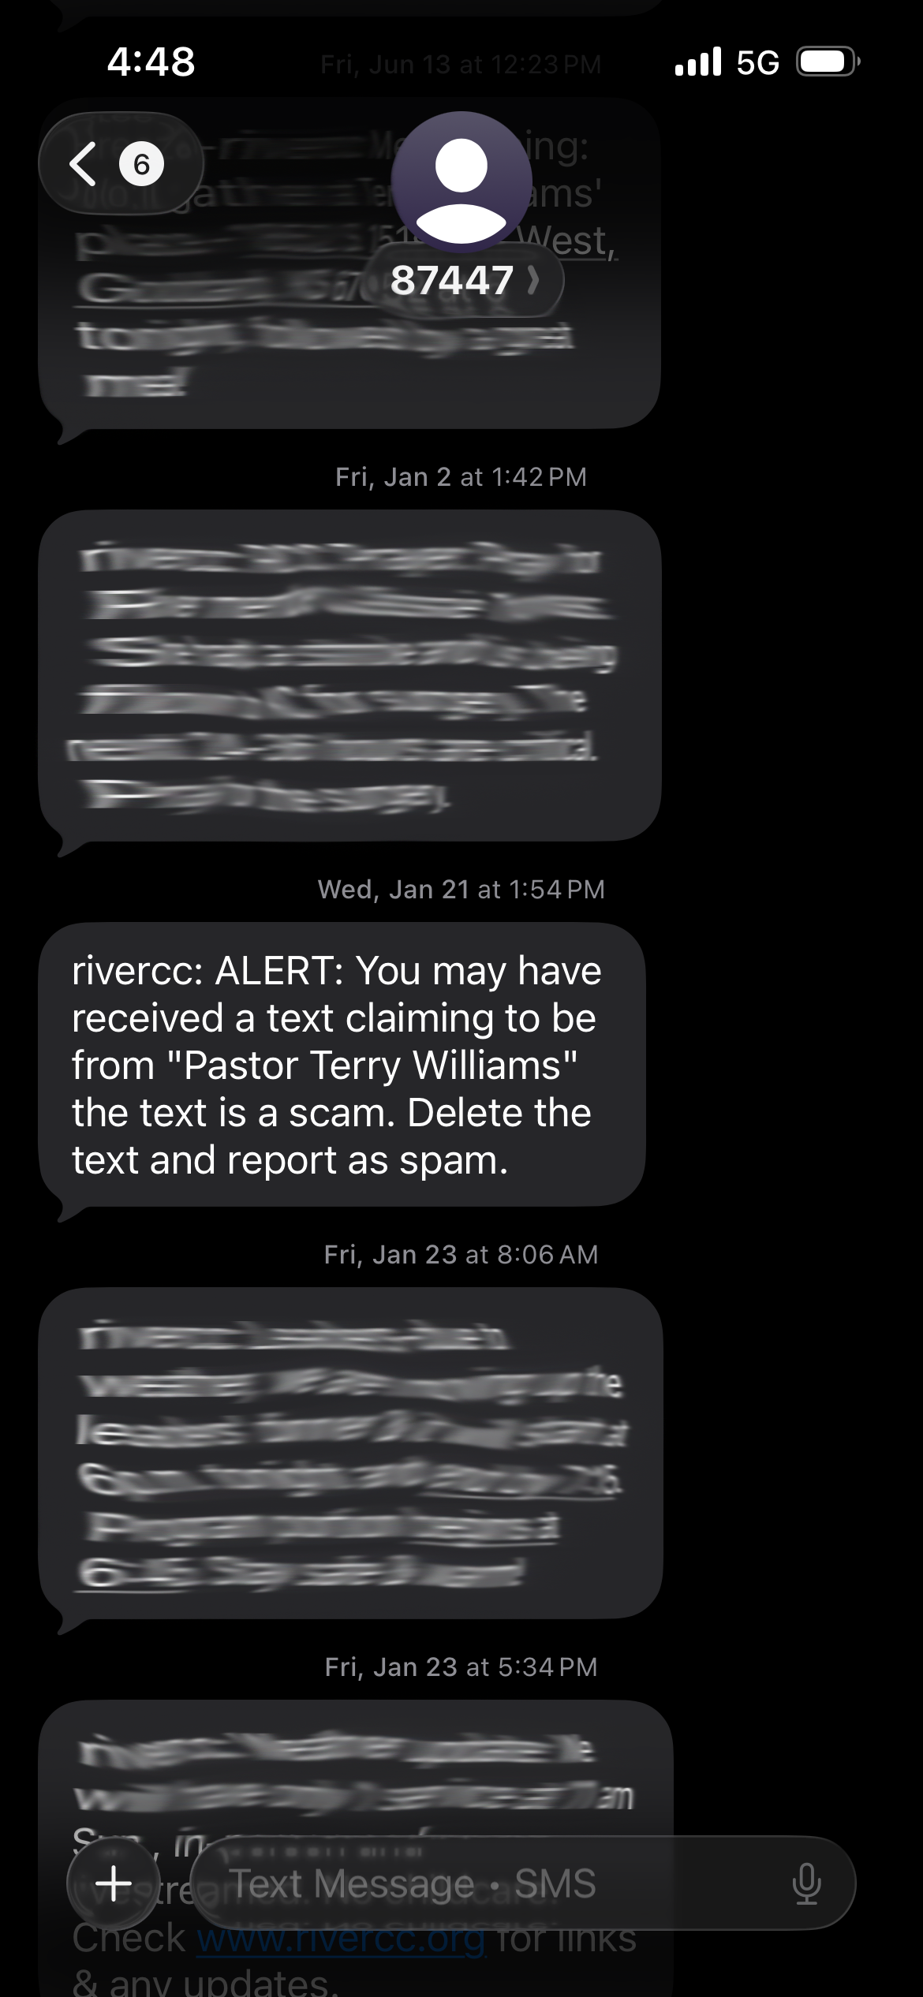
Deception
Correction

Slide 2
¹⁴ I hope to come to you soon, but I am writing these things to you so that, ¹⁵ if I delay, you may know how one ought to behave in the household of God, which is the church of the living God, a pillar and buttress of the truth. ¹⁶ Great indeed, we confess, is the mystery of godliness:
He was manifested in the flesh, vindicated by the Spirit, seen by angels, proclaimed among the nations, believed on in the world, taken up in glory.
1 Timothy 3:14-16

Slide 3
³ As I urged you when I was going to Macedonia, remain at Ephesus so that you may charge certain persons not to teach any different doctrine, ⁴ nor to devote themselves to myths and endless genealogies, which promote speculations rather than the stewardship from God that is by faith…⁶ Certain persons, by swerving from these, have wandered away into vain discussion, ⁷ desiring to be teachers of the law, without understanding either what they are saying or the things about which they make confident assertions.
1 Timothy 1:3-7

Slide 4
¹ Now the Spirit expressly says that in later times some will depart from the faith by devoting themselves to deceitful spirits and teachings of demons, ² through the insincerity of liars whose consciences are seared, ³ who forbid marriage and require abstinence from foods that God created to be received with thanksgiving by those who believe and know the truth. ⁴ For everything created by God is good, and nothing is to be rejected if it is received with thanksgiving, ⁵ for it is made holy by the word of God and prayer.
1 Timothy 4:1-5

Slide 5
The Deception
¹ Now the Spirit expressly says that in later times some will depart from the faith by devoting themselves to deceitful spirits and teachings of demons, ² through the insincerity of liars whose consciences are seared, ³ who forbid marriage and require abstinence from foods that God created to be received with thanksgiving by those who believe and know the truth.
1 Timothy 4:1-3

Slide 6
The Deception
“…many will fall away and betray one another and hate one another. And many false prophets will arise and lead many astray. And because lawlessness will be increased, the love of many will grow cold. But the one who endures to the end will be saved.”
Matthew 24:10-13

Slide 7
The Deception
¹ Now the Spirit expressly says that in later times some will depart from the faith by devoting themselves to deceitful spirits and teachings of demons, ² through the insincerity of liars whose consciences are seared, ³ who forbid marriage and require abstinence from foods that God created to be received with thanksgiving by those who believe and know the truth.
1 Timothy 4:1-3

Slide 8
The Deception
Be careful who you give influence in your life.
Prioritize listening to real people in our body who you know and who know you, not some outside voice that never gets cross-examined.
Above all else, commit to knowing the truth by first-hand experience. Don’t depend on someone else to tell you what the Bible says; read it for yourself.

Slide 9
The Deception
¹ Now the Spirit expressly says that in later times some will depart from the faith by devoting themselves to deceitful spirits and teachings of demons, ² through the insincerity of liars whose consciences are seared, ³ who forbid marriage and require abstinence from foods that God created to be received with thanksgiving by those who believe and know the truth.
1 Timothy 4:1-3

Slide 10
The Correction
Marriage was part of God’s good design in creation
Although the Fall brought frustration into the husband-wife relationship, the rest of Scripture resolutely upholds marriage as a good, desirable institution of God
“Let marriage be held in honor among all…” (Hebrews 3:14)

Slide 11
The Correction
Food was also part of God’s good design in creation
“And the Lord God planted a garden in Eden, in the east, and there he put the man whom he had formed. And out of the ground the Lord God made to spring up every tree that is pleasant to the sight and good for food…¹⁶ And the Lord God commanded the man, saying, “You may surely eat of every tree of the garden, ¹⁷ but of the tree of the knowledge of good and evil you shall not eat…” (Gen. 2:8-9, 16-17)

Slide 12
The Correction
Food was also part of God’s good design in creation
Although the Fall brought toil into the man-food relationship (Gen. 3:19), God’s gracious provision of food expands after the flood to include animals, in addition to plants (Gen. 9:3)
Old Testament food laws were temporary, covenantal restrictions fulfilled and annulled in Christ (Mark 7:14-20)
“What God has made clean, do not call common.” (Acts 10:15)

Slide 13
The Correction
⁴ For everything created by God is good, and nothing is to be rejected if it is received with thanksgiving, ⁵ for it is made holy by the word of God and prayer.
1 Timothy 4:4-5
When sin entered the world, it didn’t obliterate God’s good design, but it did cause disorder and disfunction. God’s creation is still good by design, but it now groans with disorder.

Slide 14
The Correction: The Word of God
⁴ For everything created by God is good, and nothing is to be rejected if it is received with thanksgiving, ⁵ for it is made holy by the word of God and prayer.
1 Timothy 4:4-5
Life is made holy to us in the Word of God and by the Word of God

Slide 15
The Correction: Thanksgiving
⁴ For everything created by God is good, and nothing is to be rejected if it is received with thanksgiving, ⁵ for it is made holy by the word of God and prayer.
1 Timothy 4:4-5
Life is made holy to us when it is received with thanksgiving

Slide 16
The Correction: Prayer
⁴ For everything created by God is good, and nothing is to be rejected if it is received with thanksgiving, ⁵ for it is made holy by the word of God and prayer.
1 Timothy 4:4-5
Life is made holy to us by prayer

