Slide 1
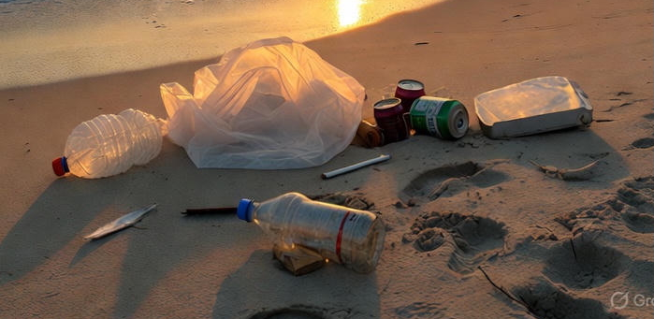

Slide 2
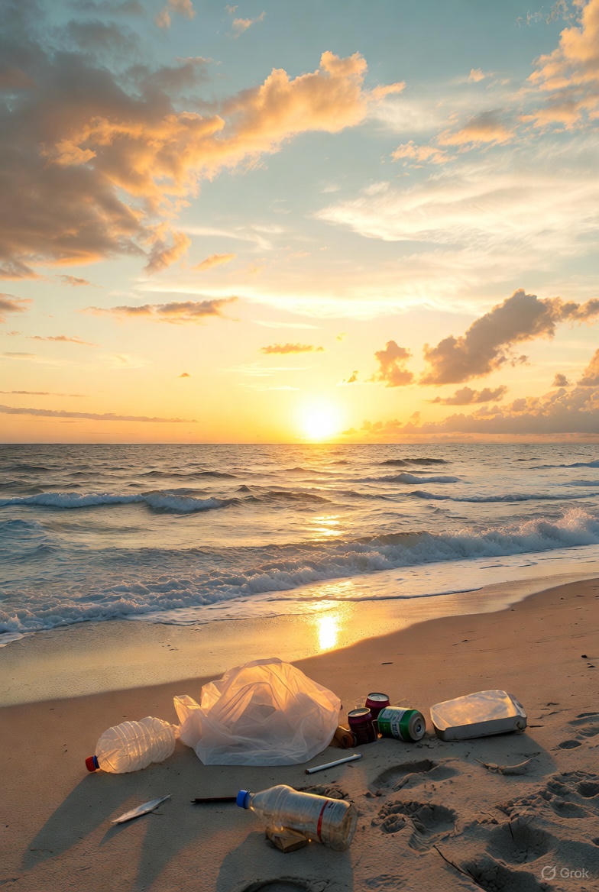

Slide 4
Ask, and it will be given to you; seek, and you will find; knock, and it will be opened to you. For everyone who asks receives, and the one who seeks finds, and to the one who knocks it will be opened. Or which one of you, if his son asks him for bread, will give him a stone? Jesus Matthew 7

Slide 5
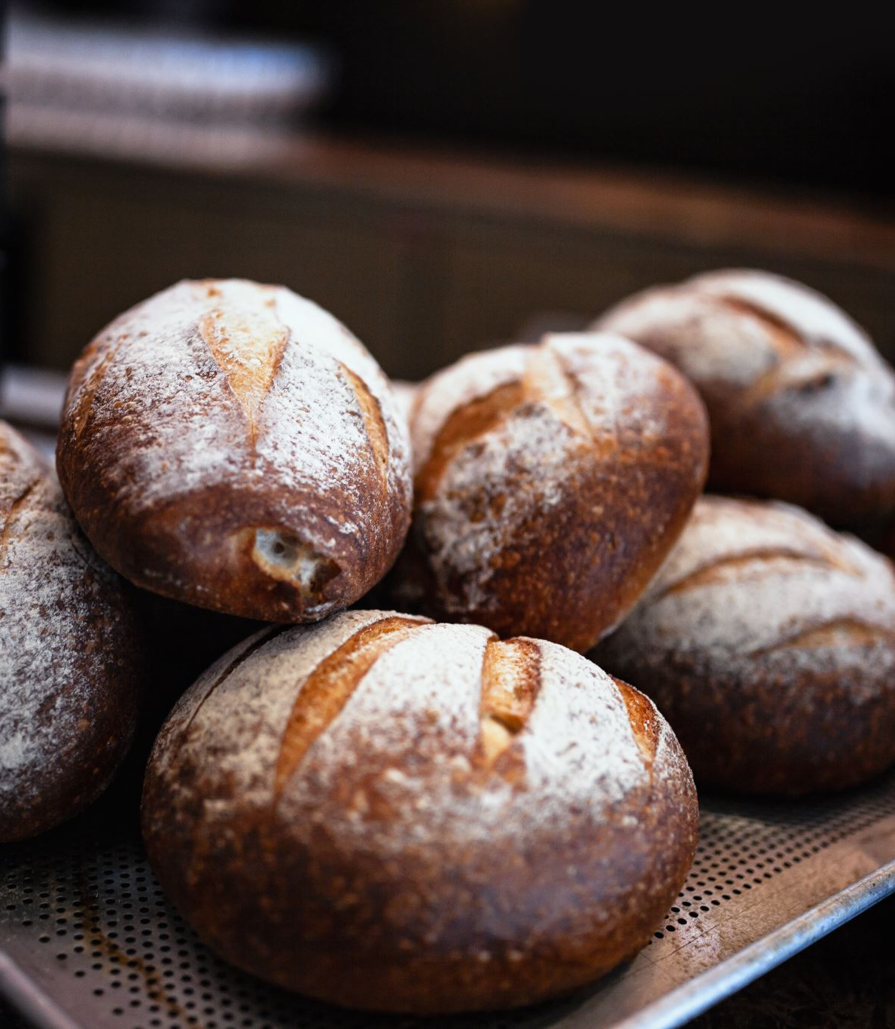
I needed bread, I got a stone.

Slide 7
“I am the bread of life. Whoever comes to me will never go hungry."

Slide 8
I thank Christ Jesus our Lord, who has given me strength, that he considered me faithful, appointing me to his service. Even though I was once a blasphemer and a persecutor and a violent man, I was shown mercy because I acted in ignorance and unbelief. The grace of our Lord was poured out on me abundantly, along with the faith and love that are in Christ Jesus. Here is a trustworthy saying that deserves full acceptance: Christ Jesus came into the world to save sinners—of whom I am the worst. But for that very reason I was shown mercy so that in me, the worst of sinners, Christ Jesus might display his unlimited patience as an example for those who would believe on him and receive eternal life.

Slide 9
Now to the King eternal, immortal, invisible, the only God, be honor and glory
forever and ever. Amen.

Slide 10
Frame #1:
Christ is the source of your strength in ministry and in life

Slide 11
Self-confidence or Self-doubt Are both about self

Slide 12
Frame #2:
Jesus saves sinners

Slide 13
Here is a trustworthy saying that deserves full acceptance: Christ Jesus came into the world to save sinners—of whom I am the worst. But for that very reason I was shown mercy so that in me, the worst of sinners, Christ Jesus might display his unlimited patience as an example for those who would believe on him and receive eternal life.

Slide 14
There is very little room for pettiness in our lives when we are living on the front lines of God’s mission.

Slide 15
Frame #3:
Jesus is the King over all

Slide 16
Now to the King eternal, immortal, invisible, the only God, be honor and glory for ever and ever. Amen.

Slide 17
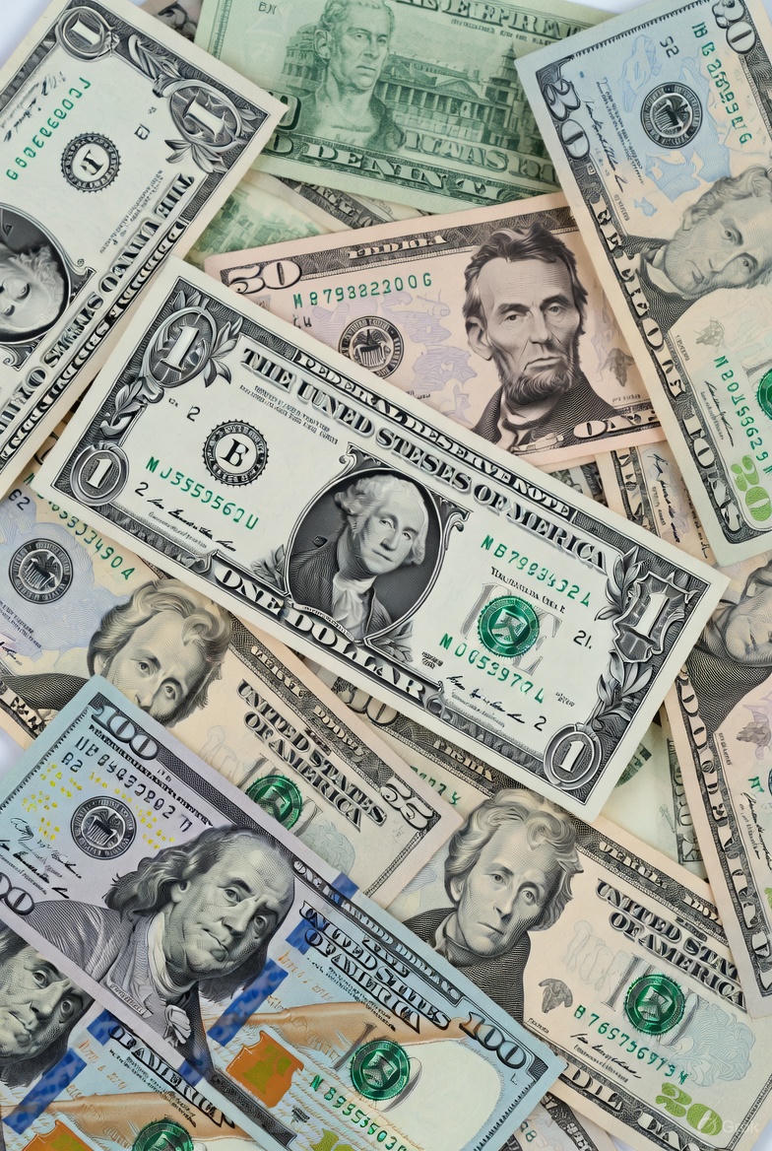
Many dead Presidents... Only one Eternal King

Slide 18
Now to the King eternal, immortal, invisible, the only God, be honor and glory forever and ever. Amen.

