Slide 1

The enemy is not amazing, he is evil.
Knowing and Loving Christ and Making Christ’s Love Known to Others

Slide 2
“There are two equal and opposite errors into which our race can fall about demons. One is to disbelieve in their existence. The other is to believe, and to feel an excessive and unhealthy interest in them.”
CS Lewis, The Screwtape Letters
Knowing and Loving Christ and Making Christ’s Love Known to Others

Slide 3

Science vs Scientism

Slide 4
Timothy, my son, I am giving you this instruction in keeping with the prophecies previously made about you, so that by recalling them you may fight the good fight, having faith and a good conscience, which some have rejected and have shipwrecked their faith. Among them are Hymenaeus and Alexander, whom I have delivered to Satan, so that they may be taught not to blaspheme. 1 Timothy 1:18-20

Slide 5
1. What is Paul talking regarding these prophecies made about Timothy? 2. What does Paul mean by "the good fight"? 3. What is this "delivering over to Satan" all about?

Slide 6
1. What is Paul talking regarding these prophecies made about Timothy?

Slide 7
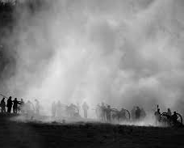
The Fog and Friction of War

Slide 8
You don’t need a personalized prophecy you have God’s finished word.

Slide 9
“I am sure of this, that he who started a good work in you will carry it on to completion until the day of Christ Jesus." Phil 1:6

Slide 10
"All authority in heaven and on earth has been given to me. Therefore, go and make disciples of all nations, baptizing them in the name of the Father and of the Son and of the Holy Spirit, and teaching them to obey everything I have commanded you. And surely I am with you always, to the very end of the age.” Matt. 28:19,20

Slide 11
2. What does Paul mean by "the good fight"?

Slide 12


Readiness

Slide 13
Train “Left of the Bang”
Spiritual Readiness
TRAIN!
GROW!
PRACTICE!

Slide 14
Fight the GOOD fight. God way God’s glory

Slide 15
Flee the evil desires of youth, and pursue righteousness, faith, love and peace, along with those who call on the Lord out of a pure heart. Don’t have anything to do with foolish and stupid arguments, because you know they produce quarrels. And the Lord’s servant must not quarrel; instead, he must be kind to everyone, able to teach, not resentful. Those who oppose him he must gently instruct In the hope that God will grant them repentance leading them to a knowledge of the truth, and that they will come to their senses and escape from the trap of the devil, who has taken them captive to do his will. 2 Timothy 2:22-26

Slide 16
3. What is this "delivering over to Satan" all about?

Slide 17
Instructive and ultimately restorative...not vindictive and punitive.

Slide 18
hand that one over to Satan for the destruction of the flesh, so that his spirit may be saved in the day of the Lord. 1 Corinthians 5:5 “Father please be as gentle as you can be and as hard as you need to be.”

Slide 19
If anyone does not obey our instruction in this letter, take note of that person; don’t associate with him, so that he may be ashamed. Yet don’t consider him as an enemy but warn him as a brother. 2 Thessalonians 3:14,15

Slide 20
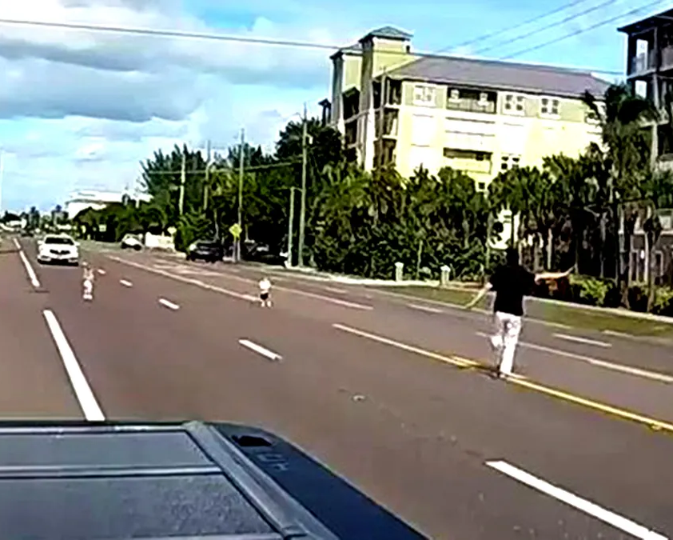
“All I want is for people to be able to do what would make them most happy.”

Slide 21
What good will it be for a man if he gains the whole world and loses his soul. -Jesus- Matthew 16:26

Slide 22
This is a real fight; we cannot be passive in it. But this fight must be fought in God's way and for God's glory. His way is the only way, and his glory is our ultimate good.

