Slide 1
Daniel 6:1-28

Slide 2
God empowers and sustains ongoing faithfulness

Slide 3
1. Faithfulness to God demands that we expect worldly opposition

Slide 4
All who desire to live a godly life in Christ Jesus will be persecuted. (2 Tim 3:12)
Beloved, do not be surprised at the fiery trial when it comes upon you to test you, as though something strange were happening to you. (1 Peter 4:12)

Slide 5


Slide 6
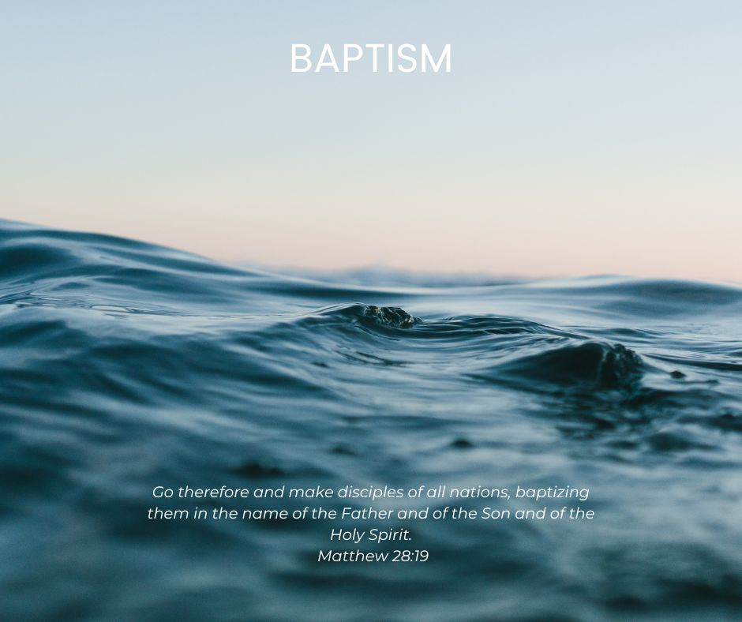

Slide 7

The era when Christians could disagree with the broader convictions of the secular world and yet still find themselves respected as decent members of society at large is coming to an end, if indeed it has not ended already.
Carl Trueman

Slide 8
2. Ordinary faithfulness prepares you for extraordinary trails.

Slide 9
When Daniel knew that the document had been signed, he went to his house where he had windows in his upper chamber open toward Jerusalem. He got down on his knees three times a day and prayed and gave thanks before his God, as he had done previously.
Daniel 6:10

Slide 10
Daniel consciously chose to obey God even when it put his own life at risk.

Slide 11
Daniel’s daily habit of prayer revealed a heart of thankfulness.

Slide 12
3. Only the living God can deliver from the power of death.

Slide 13
Daniel’s descent into the lion’s den foreshadows Jesus’ death and resurrection.

