Slide 1
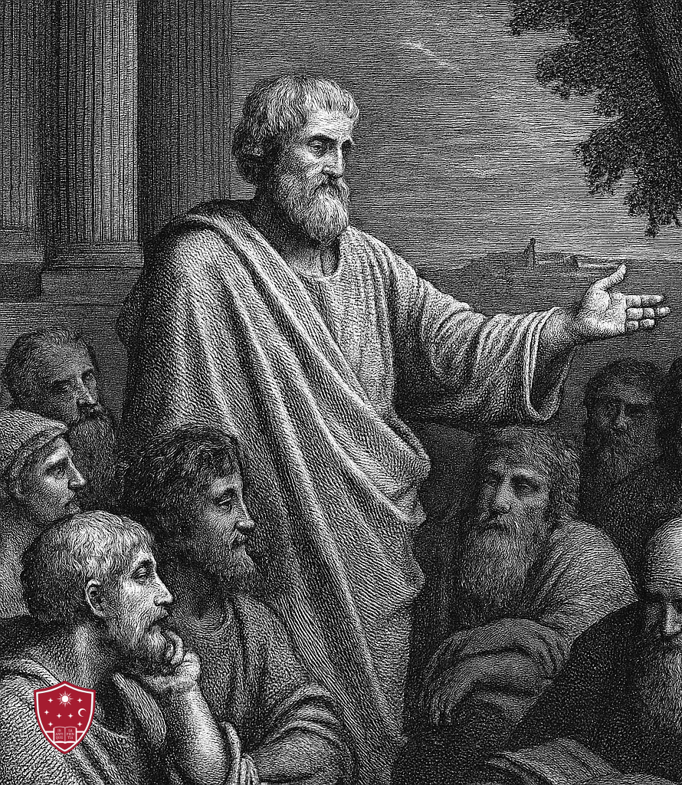
Tell them what you are going to tell them. Tell them. Tell them what you told them.

Slide 2
God
-Human history-
Israel
Individuals
Watch your life and doctrine closely. 1 Timothy 4:16

Slide 3
Esther
Sovereignty: The Principle of God’s control.
Providence: The Practice of God’s control.

Slide 4

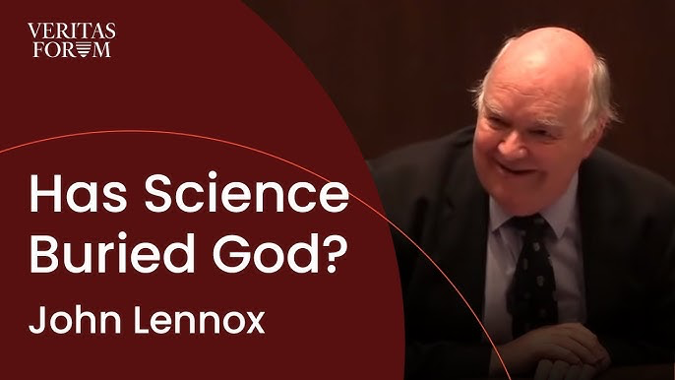
Our Faithfulness is built on God’s sovereign control.

Slide 5
It is true that God cares for each of us individually. It is not true that God’s plan is about us individually. His purpose is ultimately his own glory.

Slide 6
Esther “Purim”

Slide 7
Haman Esther 5:9-14

Slide 8
Mordecai, Esther Esther 4:1-16

Slide 9
“Who knows, perhaps you have come to your royal position for such a time as this.”

Slide 10
“If I die, I die.”

Slide 11
Macro Micro Providence

Slide 12

“Everything happens for a reason.”

Slide 13

God is completely sovereign, and I am responsible.

Slide 14

God loves me deeply and cares about me personally...but it never about me, it is always about his glory.

Slide 15
Faith “Who knows, perhaps you have come to your position for such a time as this.” Faithfulness “If I perish, I perish.”

