Slide 1
Jeremiah
Chapter 7 The Temple Sermon

Slide 2
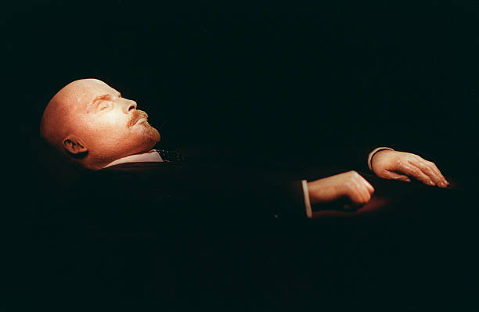
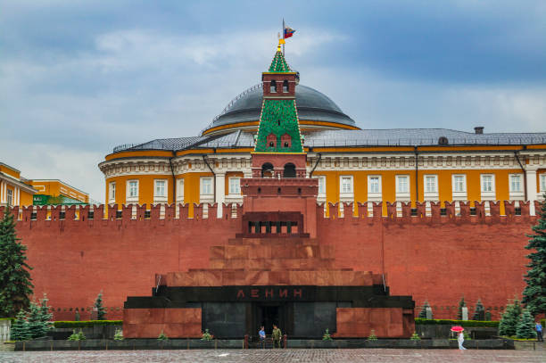
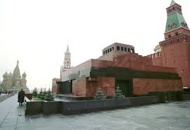
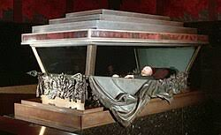
Symbolism Without Substance

Slide 3
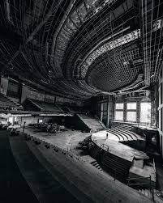
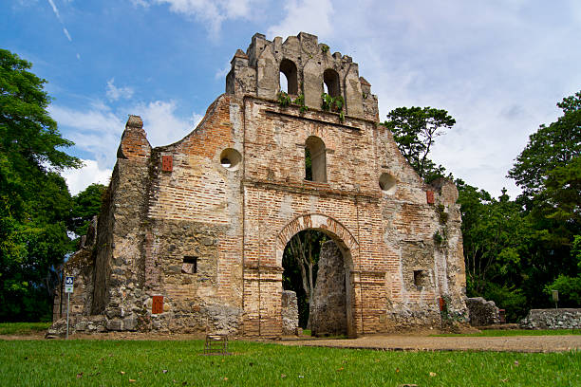
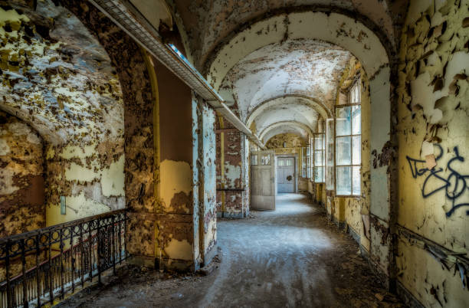
Symbolism Without Substance

Slide 4
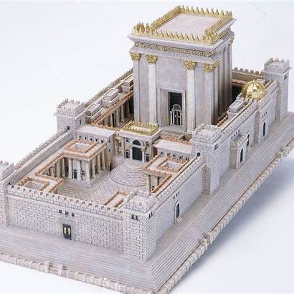
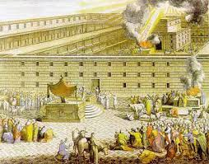
The Temple

Slide 5
Jeremiah 1:5,10
“I chose you before I formed you in the womb; I set you apart before you were born. I appointed you a prophet to the nations… See, I have appointed you today over nations and kingdoms to uproot and tear down, to destroy and demolish, to build and plant.”

Slide 6
God’s promise of a New Covenant Jeremiah 31:33-24
“This is the covenant I will make with the house of Israel after those days”—the Lord’s declaration. “I will put my teaching within them and write it on their hearts. I will be their God, and they will be my people. No longer will one teach his neighbor or his brother, saying, ‘Know the Lord,’ for they will all know me, from the least to the greatest of them”—this is the Lord’s declaration. “For I will forgive their iniquity and never again remember their sin.”

Slide 7
Reading Jeremiah: Two Threads to Watch For
Jeremiah’s heavy calling: He spoke God’s hard truth to a stubborn people.
God’s greater promise: The hope of a New Covenant that points us to Jesus.
Key takeaway: God judges sin, yet He always holds out hope.

Slide 8
Jeremiah Reveals God’s Heart
God grieves over sin yet is relentless in love.
Two questions to consider:
What needs to be torn down in my life?
What does God want to plant instead?

Slide 9
Jeremiah 7:1-8
“This is the word that came to Jeremiah from the Lord: ‘Stand in the gate of the house of the Lord and there call out this word: Hear the word of the Lord, all you people of Judah who enter through these gates to worship the Lord. This is what the Lord of Armies, the God of Israel, says: Correct your ways and your actions, and I will allow you to live in this place. Do not trust deceitful words, chanting, “This is the temple of the Lord, the temple of the Lord, the temple of the Lord.” Instead, if you really correct your ways and your actions, if you act justly toward one another, if you no longer oppress the resident alien, the fatherless, and the widow and no longer shed innocent blood in this place or follow other gods bringing harm on yourselves, I will allow you to live in this place, the land I gave to your ancestors long ago and forever.’ ⁸ But look, you keep trusting in deceitful words that cannot help.”

Slide 10
Jeremiah 7:1-8
“This is the word that came to Jeremiah from the Lord: ‘Stand in the gate of the house of the Lord and there call out this word: Hear the word of the Lord, all you people of Judah who enter through these gates to worship the Lord. This is what the Lord of Armies, the God of Israel, says: Correct your ways and your actions, and I will allow you to live in this place. Do not trust deceitful words, chanting, “This is the temple of the Lord, the temple of the Lord, the temple of the Lord.” Instead, if you really correct your ways and your actions, if you act justly toward one another, if you no longer oppress the resident alien, the fatherless, and the widow and no longer shed innocent blood in this place or follow other gods bringing harm on yourselves, I will allow you to live in this place, the land I gave to your ancestors long ago and forever.’ ⁸ But look, you keep trusting in deceitful words that cannot help.”

Slide 11
Jeremiah 7:9-11
⁹ “ ‘Do you steal, murder, commit adultery, swear falsely, burn incense to Baal, and follow other gods that you have not known? ¹⁰ Then do you come and stand before me in this house that bears my name and say, “We are rescued, so we can continue doing all these detestable acts”? ¹¹ Has this house, which bears my name, become a den of robbers in your view? Yes, I too have seen it.

Slide 12
The Warning of Jeremiah
Then and now, the warning is the same: God won’t tolerate worship that hides rebellion.

Slide 13
Jeremiah 7:12
¹² But return to my place that was at Shiloh, where I made my name dwell at first. See what I did to it because of the evil of my people Israel.

Slide 14
Jeremiah 7:16-17
As for you, do not pray for these people. Do not offer a cry or a prayer on their behalf, and do not beg Me—for I will not listen to you. Don’t you see how they behave in the cities of Judah and the streets of Jerusalem?

Slide 15
Jeremiah 7:20-34
“²¹…Add your burnt offerings to your other sacrifices, and eat the meat yourselves, ²² for when I brought your ancestors out of the land of Egypt, I did not speak with them or command them concerning burnt offering and sacrifice. ²³ However, I did give them this command: ‘Obey me, and then I will be your God, and you will be my people. Follow every way I command you so that it may go well with you.’ ²⁴ Yet they didn’t listen or pay attention but followed their own advice and their own stubborn, evil heart. They went backward and not forward.

Slide 16
John 5: 6-9
‘When Jesus saw him lying there and knew he had been there a long time, He said to him, “Do you want to get well?” “Sir,” the man answered, “I have no one to put me into the pool when the water is stirred, but while I’m coming, someone goes down ahead of me.” “Get up,” Jesus told him, “pick up your mat and walk.” Instantly the man got well, picked up his mat, and started to walk.’ vv. 6-9 CSB

Slide 17
John 39-40 The Jewish leaders missed it completely
You pour over the Scriptures because you think you have eternal life in them, and yet they testify about Me. But you are not willing to come to Me so that you may have life.

Slide 18
Conclusion: the Warning Still Stands
if we cling to our religious practices but ignore the Lord they point to, we’re no better off than they were.

Slide 19
Conclusion: the Warning Still Stands
If we cling to our religious practices but ignore the Lord they point to, we’re no better off than they were.
So what do we do with that warning? We turn back to God—He wants our hearts; He wants us to trust Him—the Savior—trust in Jesus.

Slide 20
Personal Reflection
What talismans have we built? What are we clinging to for spiritual security that isn’t Christ Himself?

Slide 21
Personal Application Bring it home…
2 Kings 17:41 They feared the Lord but also worshiped their own gods.

Slide 22
Personal Application Bring it home…
What needs to be torn down in my life?
What does God want to plant instead?
Am I really trusting Jesus — or just the things around Him?

