Slide 1
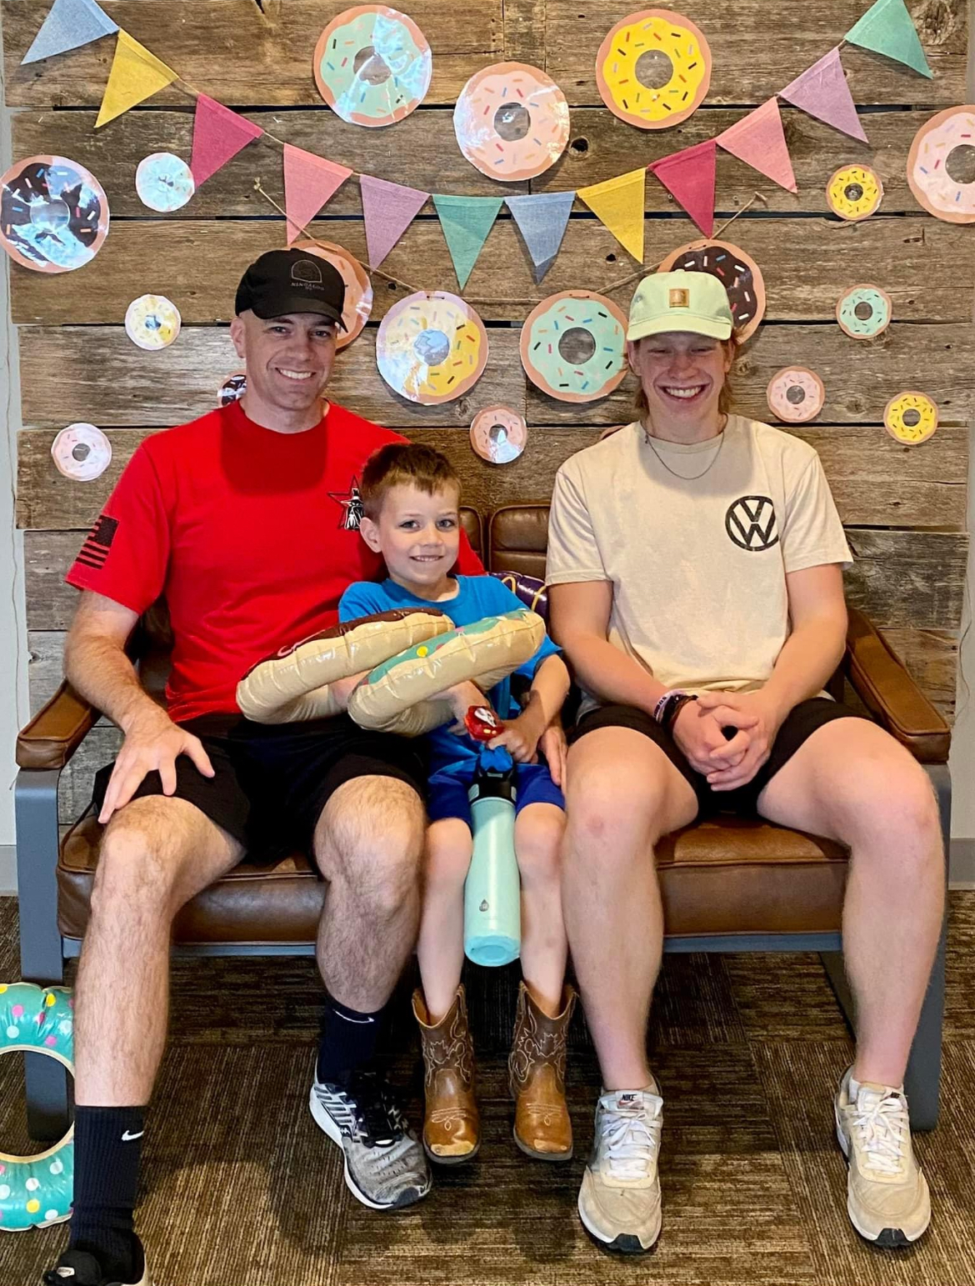

Slide 2
“My people have committed two sins: They have forsaken me, the spring of living water, and have dug their own cisterns, broken cisterns that cannot hold water. Jeremiah 2:13

Slide 3
In the meantime the disciples kept urging him, “Rabbi, eat something.” But he said, “I have food to eat that you don’t know about.” The disciples said to one another, “Could someone have brought him something to eat?” John 4:31-33

Slide 4
“My food is to do the will of him who sent me and to finish his work,” John 4:34

Slide 5
God humbled you, causing you to hunger and then feeding you with manna, which neither you nor your fathers had known, to teach you that man does not live on bread alone but on every word that comes from the mouth of the Lord Deuteronomy 8:3

Slide 6
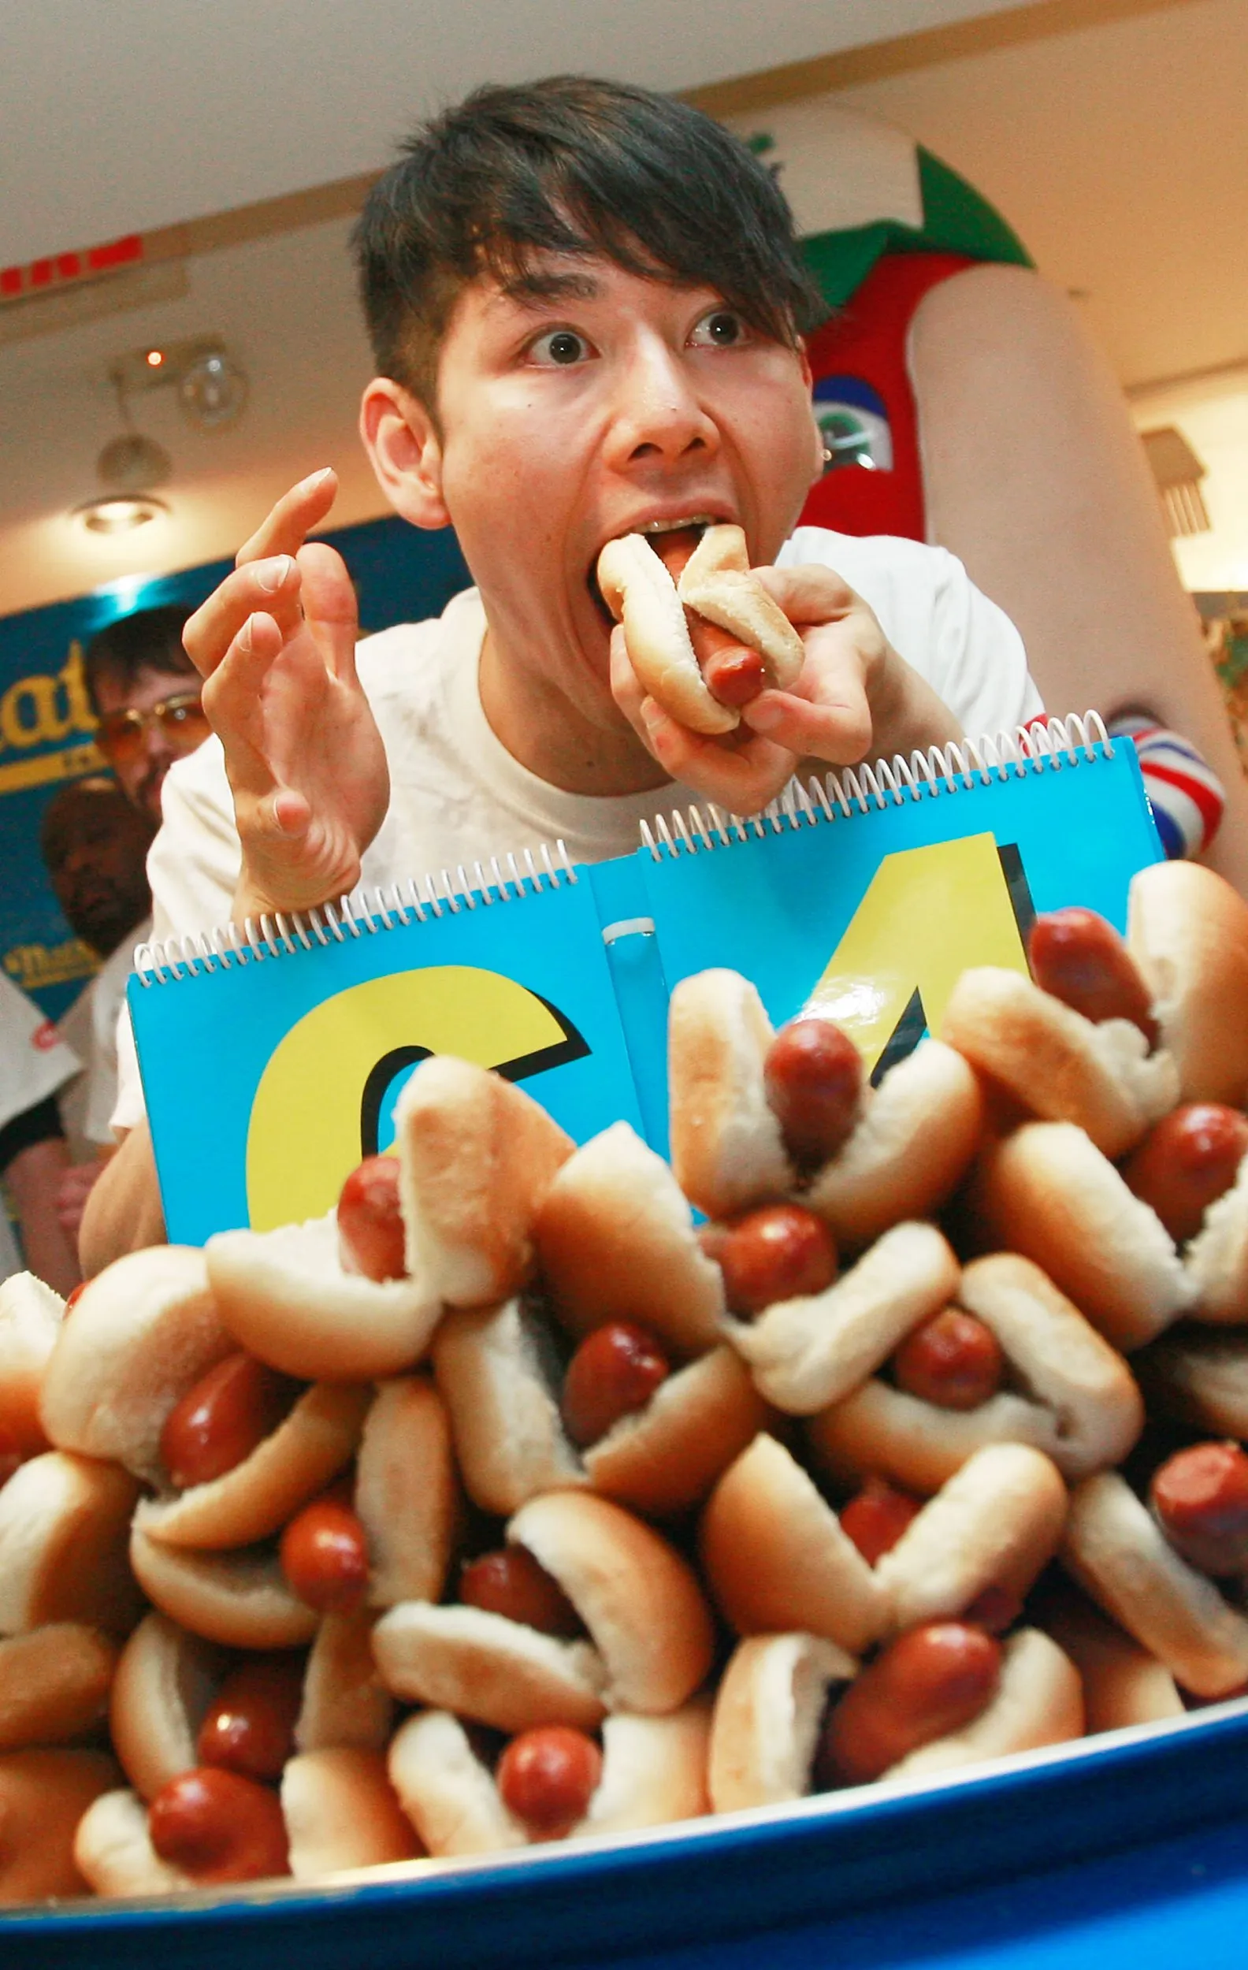

Slide 7
And they told the woman, “We no longer believe because of what you said, since we have heard for ourselves and know that this really is the Savior of the world.” John 4:42

Slide 8
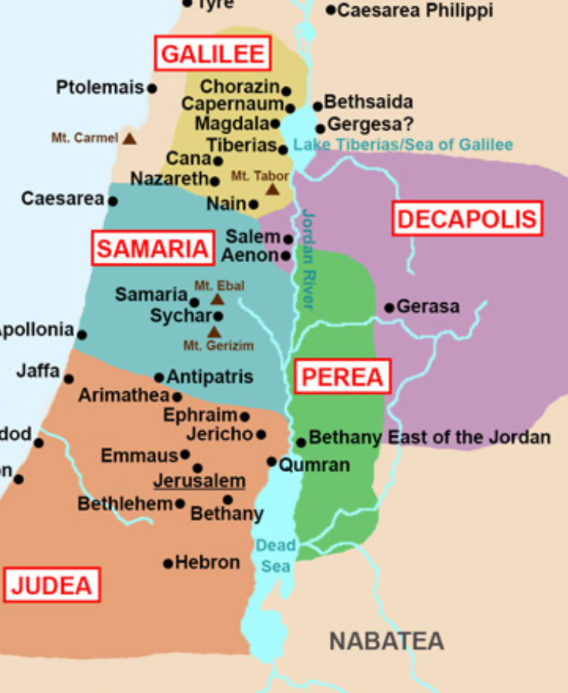

Slide 9
After two days he left there for Galilee. (Jesus himself had testified that a prophet has no honor in his own country.) When they entered Galilee, the Galileans welcomed him because they had seen everything he did in Jerusalem during the festival. For they also had gone to the festival. John 4:43-45

Slide 10
After two days he left there for Galilee. (Jesus himself had testified that a prophet has no honor in his own country.) When they entered Galilee, the Galileans welcomed him because they had seen everything he did in Jerusalem during the festival. For they also had gone to the festival. John 4:43-45

Slide 11
He went again to Cana of Galilee, where he had turned the water into wine. There was a certain royal official whose son was ill at Capernaum. When this man heard that Jesus had come from Judea into Galilee, he went to him and pleaded with him to come down and heal his son, since he was about to die. Jesus told him, “Unless you people see signs and wonders, you will not believe.” “Sir,” the official said to him, “come down before my boy dies.” “Go,” Jesus told him, “your son will live.” The man believed what Jesus said to him and departed. John 4:46-50

Slide 12
While he was still going down, his servants met him saying that his boy was alive. He asked them at what time he got better. “Yesterday at one in the afternoon the fever left him,” they answered. The father realized this was the very hour at which Jesus had told him, “Your son will live.” So, he himself believed, along with his whole household. Now this was also the second sign Jesus performed after he came from Judea to Galilee. John 4

Slide 13
Deconstructing Faith -A new term for an old reality-

Slide 14
Disillusionment is sometimes a consequence of having believed in an illusion.

Slide 15
Communicate Demonstrate Celebrate -The reality of the gospel-

