Slide 3
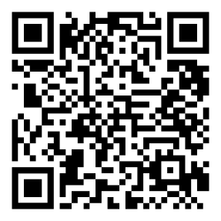
River Christian Training
The Godly Home: Biblical Foundations for the Family
Sun. Mar. 10th, 17th and 24th
2:30-4 p.m.
To register, go to rivercc.org/rct
or scan the qr code below.

Slide 4
PARENTING PANELS
Wednesday March 27
6:00PM

Slide 5
Theology is the truth of God applied to our lives.

Slide 6
1. Believe you have more control than you do. 2. Believe you have less agency than you do.

Slide 7
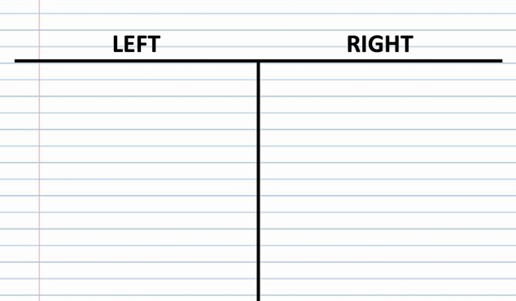

Slide 8
So then, men ought to regard us as servants of Christ and as those entrusted with the secret things of God. Now it is required that those who have been given a trust must prove faithful. 1 Cor. 4:1,2

Slide 9
It doesn’t all depend on me. I cannot guarantee all outcomes. Don’t chase shiny objects!

Slide 10
Philosophy (Love of Wisdom)

Slide 11
Parenting Works, just keep doing it.

Slide 12
1. What is your goal? 2. What is your role? 3. What principles and processes will you put in place?

Slide 13
1. Goal as a parent. For by him all things were created: things in heaven and on earth, visible and invisible, whether thrones or powers or rulers or authorities; all things were created by him and for him. Col. 1:16

Slide 14
2. Role as a parent. Be found faithful. 1 Corinthians 4:2

Slide 15
3. Faithfulness lived out in action. -Faithfulness requires community -Faithfulness is direction not perfection

Slide 16
1. Long term faithfulness requires community.

Slide 17
2. Faithfulness is direction not perfection.

Slide 18
Relationship with God is essential.

Slide 19
Above all else guard your heart, out of it flow all the issues of life. Proverbs 4:23 Do not be anxious about anything, but in everything, by prayer and petition, with thanksgiving, present your requests to God. And the peace of God, which transcends all understanding, will guard your hearts and your minds in Christ Jesus. Philippians 4:6,7

Slide 20
Do I get a guarantee?

Slide 21
Train up a child in the way he should go and when he is old he will not turn from it. Proverbs 22:6 The fear of the LORD adds length to life, but the years of the wicked are cut short. Proverbs 10:27

Slide 22
Parent with Proactive Humility

Slide 23
1. Real 2. Fun 3. Secure

Slide 24
Are you in the next generation?

Slide 25
What is your role with the next generation?

