Slide 1
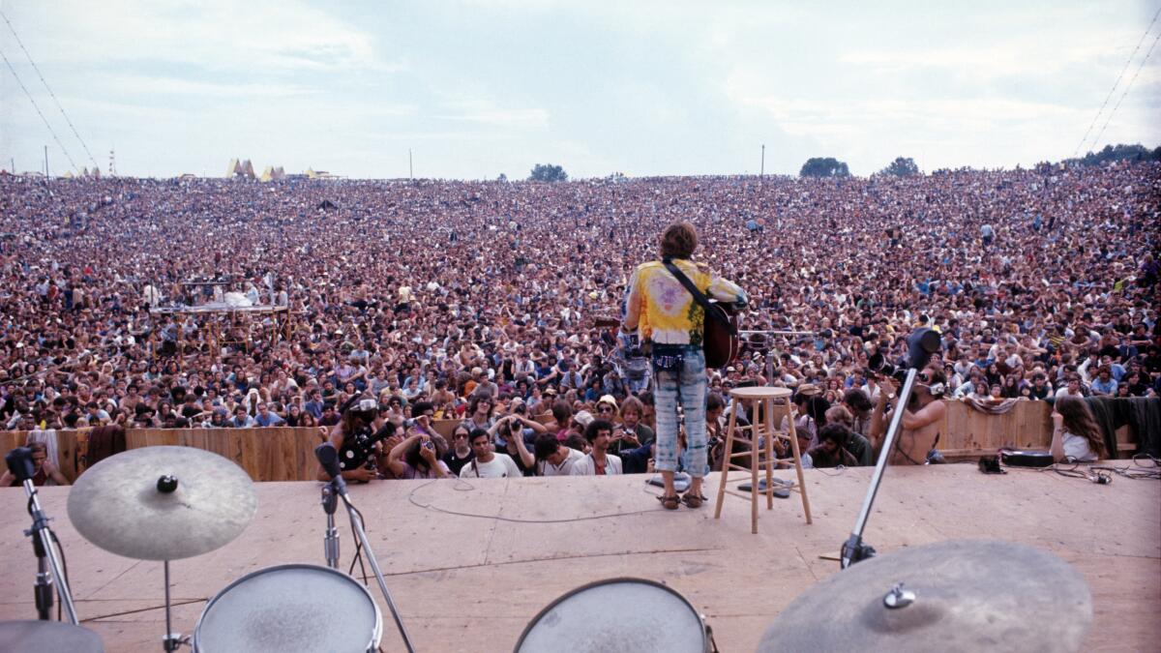

Slide 2
Every generation Blames the one before And all of their frustrations Come beating on your door I know that I'm a prisoner To all my Father held so dear I know that I'm a hostage To all his hopes and fears I just wish I could have told him in the living years

Slide 3
Your turn next?

Slide 4
“Listen, Israel: The Lord our God, the Lord is one., Love the Lord your God with all your heart, with all your soul, and with all your strength. These words that I am giving you today are to be in your heart. Repeat them to your children. Talk about them when you sit in your house and when you walk along the road, when you lie down and when you get up. Bind them as a sign on your hand and let them be a symbol on your forehead., Write them on the doorposts of your house and on your city gates.” Deut. 6:4-9

Slide 5
“Listen, Israel: Deut. 6:4-9

Slide 6
The Lord our God, the Lord is one Deut. 6:4-9

Slide 7
Love the Lord your God with all your heart, with all your soul, and with all your strength. Deut. 6:4-9

Slide 8
These words that I am giving you today are to be in your heart. Deut. 6:4-9

Slide 9
“This is the covenant I will make with the people of Israel after that time,” declares the LORD. “I will put my law in their minds and write it on their hearts. I will be their God, and they will be my people. Jeremiah 31:33

Slide 10
"But the Helper, the Holy Spirit, whom the Father will send in my name, he will teach you all things and bring to your remembrance all that I have said to you." John 14:26

Slide 11
Perspicuity (clarity) Perspicuity & Perspiration (Grace & Grit)

Slide 12
Repeat them to your children. Talk about them when you sit in your house and when you walk along the road, when you lie down and when you get up. Bind them as a sign on your hand and let them be a symbol on your forehead., Write them on the doorposts of your house and on your city gates. Deut. 6:4-9

Slide 13
For everything that was written in the past was written to teach us, so that through endurance and the encouragement of the Scriptures we might have hope. Romans 14:4

Slide 14
Are you called to be a curse breaker?

Slide 15
Having believed, you were marked in him with a seal, the promised Holy Spirit, who is a deposit guaranteeing our inheritance until the redemption of those who are God’s possession—to the praise of his glory

Slide 16
The Gospel covers our guilt!

Slide 17
If you are up next, get ready now! Decide Reject Love Train

Slide 18
The church is uniquely positioned and empowered for multi-generational trust and impact.

