Slide 1
Belief

Slide 2
"The Scientific Method is the best-known way to discover how and why the world works, without our knowledge being tainted by religious, political, or philosophical values."

Slide 4
"The Scientific Method is the best-known way to discover how and why the world works, without our knowledge being tainted by religious, political, or philosophical values."

Slide 5
I believe in the science that I believe in.

Slide 6
All humans must simply say, “I believe.”

Slide 7
That which was from the beginning, which we have heard, which we have seen with our eyes, which we have looked at and our hands have touched—this we proclaim concerning the Word of life. 2 The life appeared; we have seen it and testify to it, and we proclaim to you the eternal life, which was with the Father and has appeared to us. 3 We proclaim to you what we have seen and heard, so that you also may have fellowship with us. And our fellowship is with the Father and with his Son, Jesus Christ. 4 We write this to make our joy complete. 1 John 1:1-4

Slide 8
"Jesus performed many other signs in the presence of his disciples that are not written in this book. But these are written so that you may believe that Jesus is the Messiah, the Son of God,, and that by believing you may have life in his name." John 20:30,31

Slide 9
"And there are also many other things that Jesus did, which, if every one of them were written down, I suppose not even the world itself could contain the books that would be written.” John 21:25

Slide 10
"In the beginning was the Word, and the Word was with God, and the Word was God. He was with God in the beginning. Through him all things were made; without him nothing was made that has been made." John 1:1-3

Slide 11
Word (Logos) Incarnate (Word became flesh)

Slide 12
“By the word of the Lord were the heavens made, their starry host by the breath of his mouth.” Ps 33:6

Slide 13
Jesus did not temporarily become man, but his divine nature was permanently united to his human nature, and he lives forever not just as the eternal Son of God, the second person of the Trinity, but also as Jesus, the man who was born of Mary, and as Christ, the Messiah and Savior of his people. Jesus will remain fully God and fully man, yet one person, forever. Wayne Grudem

Slide 14
“They Myth of God Incarnate” John Hick

Slide 15
"Our proper response is not to reject the clear and central teaching of Scripture about the incarnation, but simply to recognize that it will remain a paradox, that this is all that God has chosen to reveal to us about it, and that it is true. If we are to submit ourselves to God and to his words in Scripture, then we must believe it.” Wayne Grudem

Slide 16
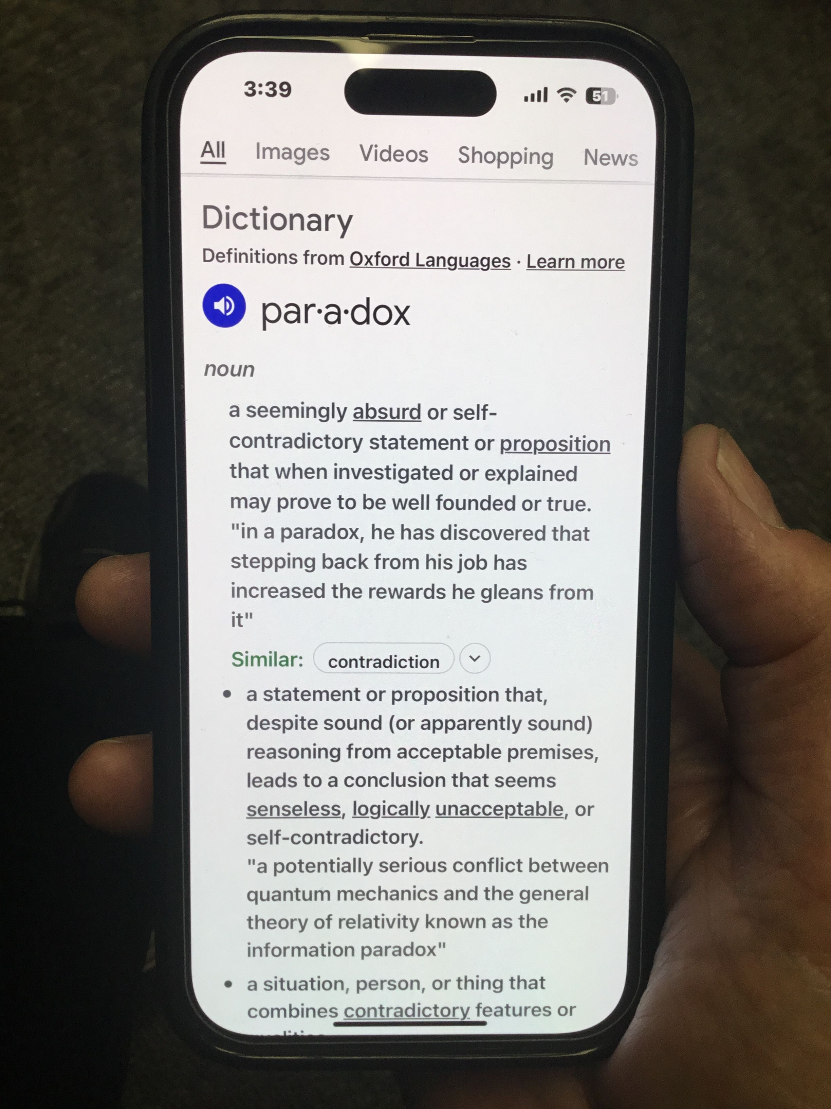

Slide 17
Do not let your hearts be troubled, just because your brain is.

Slide 18
I am... Jesus did...

Slide 19
In the beginning was the Word, and the Word was with God, and the Word was God. He was with God in the beginning. John 1:11

Slide 20
This is not merely an intellectual exercise, yet the facts are very important.

Slide 21
Don’t be an arrogant heretic hunter. "Those who oppose him he must gently instruct, in the hope that God will grant them repentance leading them to a knowledge of the truth." 2 Tim. 2:25

Slide 22
Don’t let your inability to get your mind around the incarnation deplete your certainty.

Slide 23
"Do not let your hearts be troubled. Trust in God; trust also in me. In my Father’s house are many rooms; if it were not so, I would have told you. I am going there to prepare a place for you. And if I go and prepare a place for you, I will come back and take you to be with me that you also may be where I am." John 14:1-3

