Slide 1
Exodus 34:5–8

Slide 2
A right understanding of God is required for right worship of God.

Slide 3
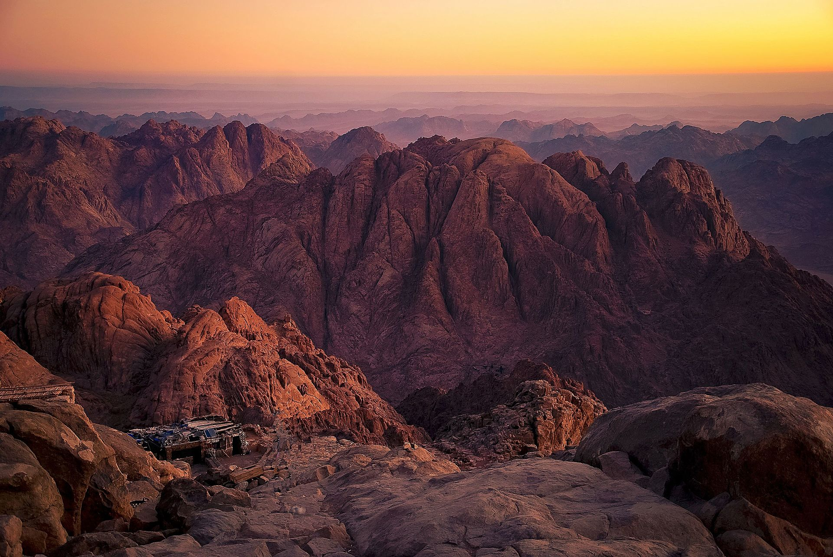

Slide 4
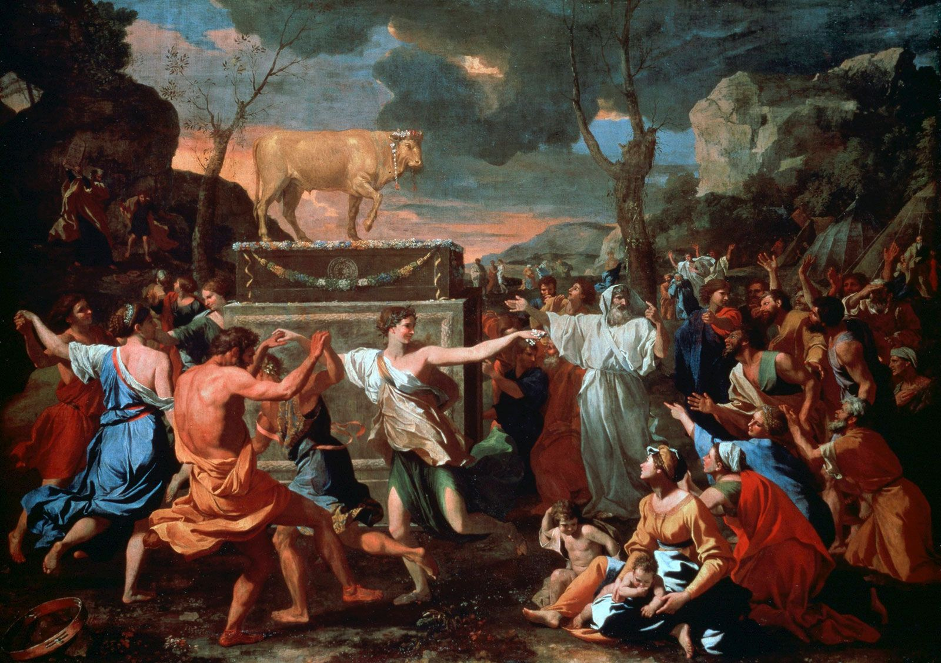

Slide 5
“Please, let me see your glory.” “I will cause all my goodness to pass in front of you, and I will proclaim the name the LORD.” Ex 33:18–19

Slide 6
⁵ The Lord came down in a cloud, stood with him there, and proclaimed his name, “the Lord.” ⁶ The Lord passed in front of him and proclaimed: The Lord—the Lord is a compassionate and gracious God, slow to anger and abounding in faithful love and truth, ⁷ maintaining faithful love to a thousand generations, forgiving iniquity, rebellion, and sin. But he will not leave the guilty unpunished, bringing the consequences of the fathers’ iniquity on the children and grandchildren to the third and fourth generation. ⁸ Moses immediately knelt low on the ground and worshiped. Ex 34:5–8

Slide 7
“The LORD is gracious and compassionate, slow to anger and great in faithful love.” Psalm 145:8

Slide 8
“…That’s why I fled to Tarshish in the first place. I knew that you are a gracious and compassionate God, slow to anger, abounding in faithful love, and one who relents from sending disaster.” Jonah 4:2

Slide 9
⁶ The Lord passed in front of him and proclaimed: The Lord—the Lord is a compassionate and gracious God, slow to anger and abounding in faithful love and truth,

Slide 10
5 Key Aspects of God’s Character 1. God is merciful 2. God is gracious 3. God is patient (longsuffering) 4. God is faithful 5. God is righteous

Slide 11
1. God is merciful ⁶ The Lord passed in front of him and proclaimed: The Lord—the Lord is a compassionate and gracious God, slow to anger and abounding in faithful love and truth,

Slide 12
God’s mercy is the goodness of God applied to those in misery. Goodness in action

Slide 13
2. God is gracious ⁶ The Lord passed in front of him and proclaimed: The Lord—the Lord is a compassionate and gracious God, slow to anger and abounding in faithful love and truth,

Slide 14
God’s grace is the goodness of God applied to those who only deserve evil. Goodness in action “unmerited favor”

Slide 15
Grace and mercy are voluntary free expressions of God’s goodness and love.

Slide 16
“What is shocking is not that God judges our sin; instead, it is that he chooses to display his grace!” – Stephen Wellum

Slide 17
3. God is patient (longsuffering) ⁶ The Lord passed in front of him and proclaimed: The Lord—the Lord is a compassionate and gracious God, slow to anger and abounding in faithful love and truth,

Slide 18
“Smoke rose from his nostrils, and consuming fire came from his mouth; coals were set ablaze by it.” Psalm 18:8

Slide 19
“Or do you despise the riches of his kindness, restraint, and patience, not recognizing that God’s kindness is intended to lead you to repentance?” Romans 2:4

Slide 20
4. God is faithful ⁶ The Lord passed in front of him and proclaimed: The Lord—the Lord is a compassionate and gracious God, slow to anger and abounding in faithful love and truth,

Slide 21
Hesed Covenant faithfulness ⁷ maintaining faithful love to a thousand generations, forgiving iniquity, rebellion, and sin.

Slide 22
5. God is righteous ⁶ The Lord passed in front of him and proclaimed: The Lord—the Lord is a compassionate and gracious God, slow to anger and abounding in faithful love and truth,

Slide 23
Righteousness Truthfulness Trustworthiness

Slide 24
God does not merely act righteous, he is righteous. God acts righteously because he is righteous.

Slide 25
⁷ maintaining faithful love to a thousand generations, forgiving iniquity, rebellion, and sin. But he will not leave the guilty unpunished, bringing the consequences of the fathers’ iniquity on the children and grandchildren to the third and fourth generation.

Slide 26
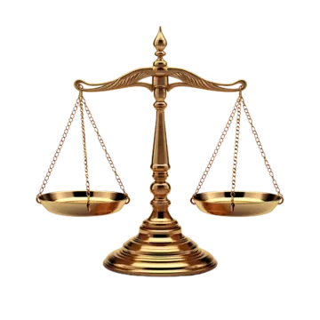

Slide 27
⁷ maintaining faithful love to a thousand generations, forgiving iniquity, rebellion, and sin. But he will not leave the guilty unpunished, bringing the consequences of the fathers’ iniquity on the children and grandchildren to the third and fourth generation.

Slide 28
The consequences of human sin can have generational ripple effects, but God’s faithful love endures forever.

Slide 30
Greater glory fulfilled in Christ

Slide 31
“The Word became flesh and dwelt among us. We observed his glory, the glory of the one and only Son from the Father, full of grace and truth.” John 1:14

Slide 32
“Full of grace and truth” John 1:14 “abounding in faithful love and truth” Exodus 34:6

Slide 34
⁸ Moses immediately knelt low on the ground and worshiped.

Slide 35
Am I worshiping God according to my terms or am I worshiping God as he has revealed himself?

