Slide 1
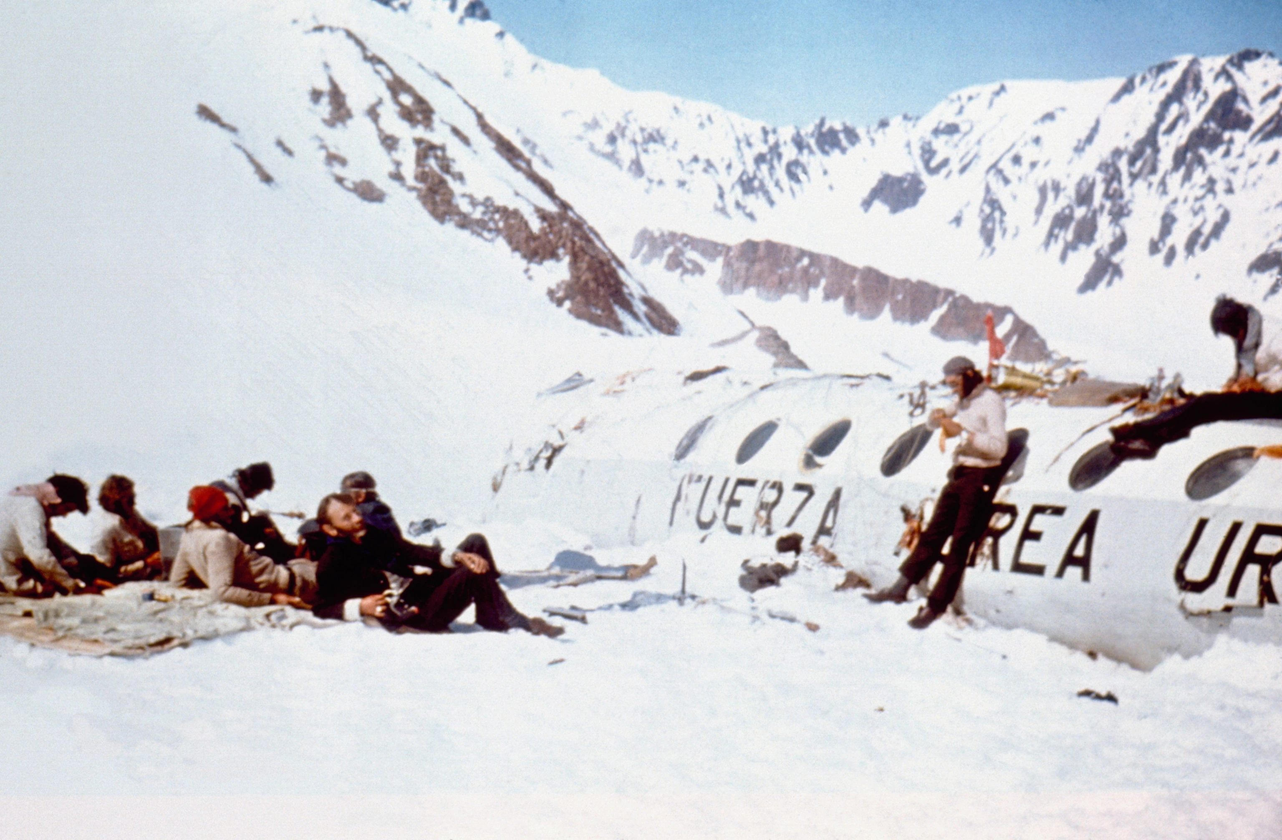

Slide 2
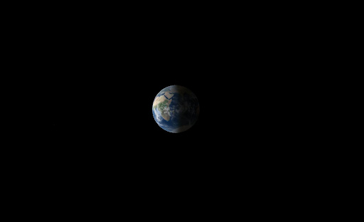

Slide 3
Don’t try to change the world
Just be faithful

Slide 4
The king said “My word is final: If you don’t tell me the dream and its interpretation, you will be torn limb from limb, and your houses will be made a garbage dump. But if you make the dream and its interpretation known to me, you’ll receive gifts, a reward, and great honor from me.
Daniel 2

Slide 5
The decree was issued that the wise men were to be executed, and they searched for Daniel and his friends, to kill them.

Slide 6
Then Daniel responded with tact and discretion to Arioch, the captain of the king’s guard,, who had gone out to execute the wise men of Babylon. He asked Arioch, the king’s officer, “Why is the decree from the king so harsh?”, Then Arioch explained the situation to Daniel. So Daniel went and asked the king to give him some time, so that he could give the king the interpretation. Then Daniel went to his house and told his friends about the matter, urging them to ask the God of the heavens for mercy concerning this mystery, so Daniel and his friends would not be destroyed with the rest of Babylon’s wise men. The mystery was then revealed to Daniel in a vision at night, and Daniel praised the God of the heavens.

Slide 7
Then King Nebuchadnezzar fell facedown, worshiped Daniel, and gave orders to present an offering and incense to him. The king said to Daniel, “Your God is indeed God of gods, Lord of kings, and a revealer of mysteries, since you were able to reveal this mystery.”

Slide 8
Grace & Grit
“May the name of God be praised forever and ever, for wisdom and power belong to him."

Slide 9
Daniel distinguished himself above the administrators because he had an extraordinary spirit, so the king planned to set him over the whole realm.
Daniel 6

Slide 10
The administrators kept trying to find a charge against Daniel regarding the kingdom. But they could find no charge or corruption, for he was trustworthy

Slide 11
The windows in its upstairs room opened toward Jerusalem, and three times a day he got down on his knees, prayed, and gave thanks to his God, just as he had done before.

Slide 12
Then these men went as a group and found Daniel petitioning and imploring his God. So they approached the king.

Slide 13
If we are thrown into the blazing furnace, the God we serve is able to save us from it, and he will rescue us from your hand, O king. But even if he does not, we want you to know, O king, that we will not serve your gods or worship the image of gold you have set up.”
Daniel 3

Slide 14
What are we to expect of God?
What does he expect of us?

Slide 15
But we have this treasure in jars of clay to show that this all-surpassing power is from God and not from us. We are hard pressed on every side, but not crushed; perplexed, but not in despair; 9persecuted, but not abandoned; struck down, but not destroyed.
2 Corinthians 4

Slide 16
God is the only hero

Slide 17
Daniel’s Grit resolved, asked, urged, praised, went, requested, was terrified, distinguished himself, got on his knees and prayed

Slide 18
Decided not Deciding

Slide 19
His life was full of trouble and yet he remained faithful

Slide 20
“I was exhausted and lay ill for several days.”
Daniel 8

Slide 21
When do we get to take credit?
When does God get the blame?
-Never-

Slide 22
Daniel’s perspective of God empowered his life of faithfulness

Slide 23
The high priest said to him, “I charge you under oath by the living God: Tell us if you are the Christ, the Son of God.” “Yes, it is as you say,” Jesus replied. “But I say to all of you: In the future you will see the Son of Man sitting at the right hand of the Mighty One and coming on the clouds of heaven.” Then the high priest tore his clothes and said, “He has spoken blasphemy! Why do we need any more witnesses? Look, now you have heard the blasphemy. What do you think?” He is worthy of death,” they answered.
Matthew 26

Slide 24
“I saw in the night visions, and behold, with the clouds of heaven there came one like a son of man, and he came to the Ancient of Days and was presented before him. And to him was given dominion and glory and a kingdom, that all peoples, nations, and languages should serve him; his dominion is an everlasting dominion, which shall not pass away, and his kingdom one that shall not be destroyed.
Daniel 7

Slide 25
Daniel’s perspective of God empowered his life of faithfulness

Slide 26
What would Daniel had missed if he not been faithful?

Slide 27
Now when Daniel learned that the decree had been published, he went home to his upstairs room where the windows opened toward Jerusalem. Three times a day he got down on his knees and prayed, giving thanks to his God, just as he had done before.

