Slide 1
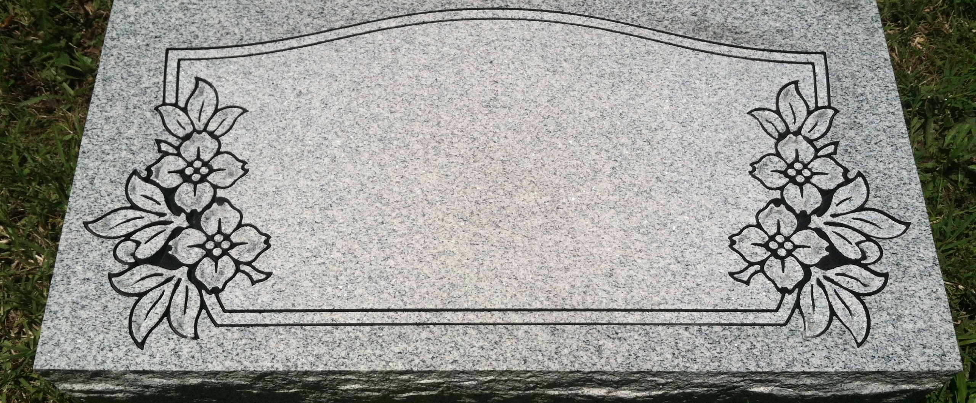

Slide 2
Therefore, I intend always to remind you of these qualities, though you know them and are established in the truth that you have. I think it right, as long as I am in this body, to stir you up by way of reminder, since I know that the putting off of my body will be soon, as our Lord Jesus Christ made clear to me. And I will make every effort so that after my departure you may be able at any time to recall these things. 2 Peter 1:12-15

Slide 3
Peter was hurt because Jesus asked him the third time, “Do you love me?” He said, “Lord, you know all things; you know that I love you.”

Slide 4
"I tell you the truth, when you were younger you dressed yourself and went where you wanted; but when you are old you will stretch out your hands, and someone else will dress you and lead you where you do not want to go.” Jesus said this to indicate the kind of death by which Peter would glorify God. Then he said to him, “Follow me!”

Slide 5
"Teach us to number our days aright, that we may gain a heart of wisdom." Ps. 90:12

Slide 6
And I will make every effort so that after my departure you may be able at any time to recall these things.

Slide 7
"After Peter and Paul’s death Mark, the disciple and interpreter of Peter, himself handed down to us in writing the substance of Peter’s preaching.” Irenaeus

Slide 8
For we did not follow cleverly devised myths when we made known to you the power and coming of our Lord Jesus Christ, but we were eyewitnesses of his majesty. For when he received honor and glory from God the Father, and the voice was borne to him by the Majestic Glory, “This is my beloved Son, with whom I am well pleased,” we ourselves heard this very voice borne from heaven, for we were with him on the holy mountain.

Slide 9
And we have the prophetic word more fully confirmed, to which you will do well to pay attention as to a lamp shining in a dark place, until the day dawns and the morning star rises in your hearts, knowing this first of all, that no prophecy of Scripture comes from someone’s own interpretation. For no prophecy was ever produced by the will of man, but men spoke from God as they were carried along by the Holy Spirit.

Slide 10
For we did not follow cleverly devised myths when we made known to you the power and coming of our Lord Jesus Christ, but we were eyewitnesses of his majesty.

Slide 11
Gospel Power for Gospel Practice

Slide 12
For when he received honor and glory from God the Father, and the voice was borne to him by the Majestic Glory, “This is my beloved Son, with whom I am well pleased,” we ourselves heard this very voice borne from heaven, for we were with him on the holy mountain.

Slide 13
After six days Jesus took Peter, James and John with him and led them up a high mountain, where they were all alone. There he was transfigured before them. His clothes became dazzling white, whiter than anyone in the world could bleach them. And there appeared before them Elijah and Moses, who were talking with Jesus. Peter said to Jesus, “Rabbi, it is good for us to be here. Let us put up three shelters—one for you, one for Moses and one for Elijah.” (He did not know what to say, they were so frightened.) Then a cloud appeared and enveloped them, and a voice came from the cloud: “This is my Son, whom I love. Listen to him!” Suddenly, when they looked around, they no longer saw anyone with them except Jesus. Mark 9

Slide 14
“Rabbi,(Peter said) it is good for us to be here. Let us put up three shelters(tents)—one for you, one for Moses and one for Elijah.” 6 (He did not know what to say, they were so frightened.)

Slide 15
And we have the prophetic word more fully confirmed.. 2 Peter 1:19

Slide 16
And we have the prophetic word more fully confirmed, to which you will do well to pay attention as to a lamp shining in a dark place, until the day dawns and the morning star rises in your hearts,

Slide 17
Why is there so much beauty, love, purpose, goodness, hope in the world?

Slide 18
Everything matters or Nothing matters

Slide 20
We did not follow cleverly invented stories when we told you about the power and coming of our Lord Jesus Christ, but we were eyewitnesses of his majesty

Slide 21
knowing this first of all, that no prophecy of Scripture comes from someone’s own interpretation. For no prophecy was ever produced by the will of man, but men spoke from God as they were carried along by the Holy Spirit.

Slide 22
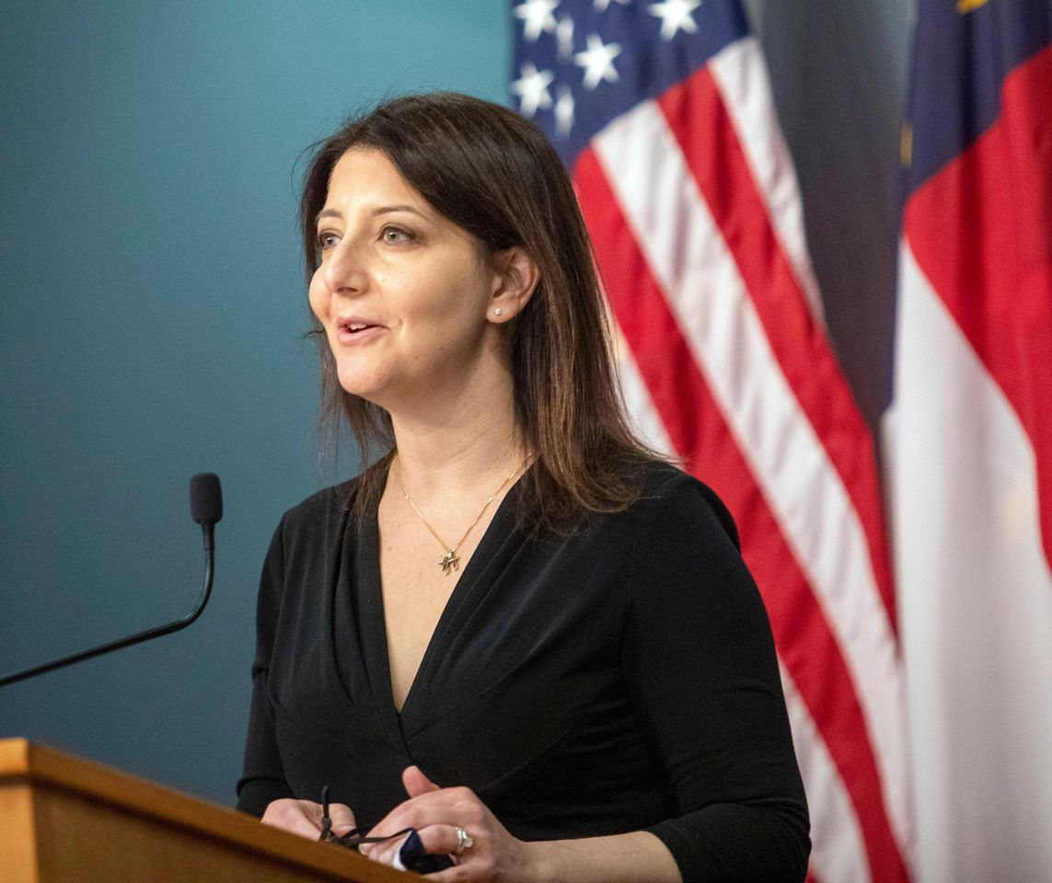
“Trust is the foundation for all relationships.”
Dr. Mandy Cohen

Slide 23
1. Trust is essential. 2. Everyone trusts someone. 3. It matters whether you trust someone who is ultimately trustworthy.

Slide 24
Limited wisdom Limited power Limited goodness

Slide 25
Unlimited wisdom Unlimited power Unlimited goodness

