Slide 1
What exactly can we expect from God? What exactly does he expect from me?

Slide 2
Since all these things are thus to be dissolved, what sort of people ought you to be in lives of holiness and godliness, waiting for and hastening the coming of the day of God, because of which the heavens will be set on fire and dissolved, and the heavenly bodies will melt as they burn! But according to his promise we are waiting for new heavens and a new earth in which righteousness dwells.

Slide 3
“The universe could have just appeared from nothing.” Richard Dawkins “What can be asserted without evidence can also be dismissed without evidence” Chris Hitchens

Slide 4
Since all these things are thus to be dissolved, what sort of people ought you to be in lives of holiness and godliness, waiting for and hastening the coming of the day of God, because of which the heavens will be set on fire and dissolved, and the heavenly bodies will melt as they burn! But according to his promise we are waiting for new heavens and a new earth in which righteousness dwells.

Slide 5
Therefore, beloved, since you are waiting for these, be diligent to be found by him without spot or blemish, and at peace.

Slide 7
Therefore, beloved, since you are waiting for these, be diligent to be found by him without spot or blemish, and at peace.

Slide 8
And count the patience of our Lord as salvation, just as our beloved brother Paul also wrote to you according to the wisdom given him, as he does in all his letters when he speaks in them of these matters. There are some things in them that are hard to understand, which the ignorant and unstable twist to their own destruction, as they do the other Scriptures.

Slide 9
You therefore, beloved, knowing this beforehand, take care that you are not carried away with the error of lawless people and lose your own stability.

Slide 10
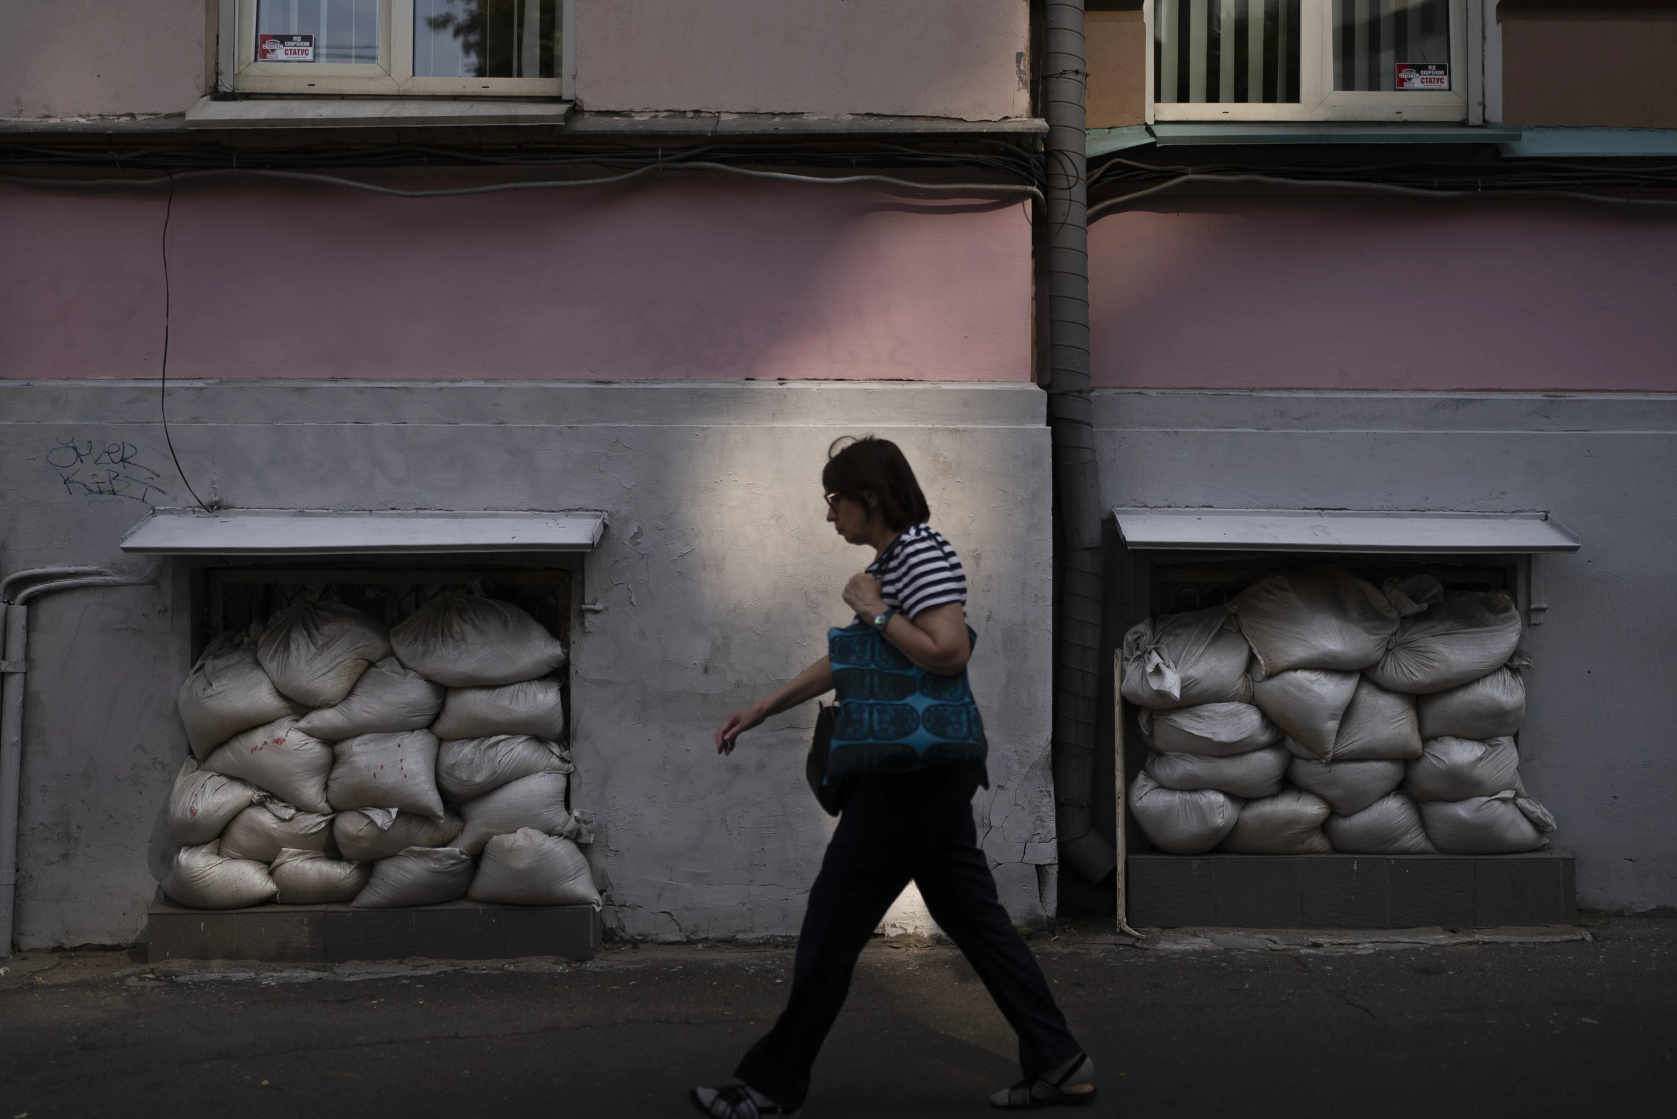

Slide 12
Truth is a vital resource

Slide 13
The spiritual battle has always been primarily about information warfare.

Slide 14
But grow in the grace and knowledge of our Lord and Savior Jesus Christ. To him be the glory both now and to the day of eternity. Amen.

Slide 15
“For this very reason...” -His divine power has given us everything we need for life and godliness- “...therefore make every effort”

Slide 16
ADD=Costly and generous cooperation

Slide 17
Love
Godliness
Endurance
Self Control
Virtue
Faith
Brotherly
Kindness

Slide 18
But grow in the grace and knowledge of our Lord and Savior Jesus Christ. To him be the glory both now and to the day of eternity. Amen.

Slide 19
Don’t live for the here and now
Personal responsibility
Faithful in the here and now
Thrive
Suffer
Live in Community

Slide 20
We can expect God to be faithful. God expects us to be faithful.

Slide 21
Don’t live for the here and now
Personal responsibility
Faithful in the here and now
Thrive
Suffer
Live in Community
Head
Heart

Slide 22
“To him be glory both now and to the day of eternity. Amen.”

