Slide 2
Don't Express Your Feelings
Believe Your Feelings

Slide 3
Feel what you feel. Believe what is real.

Slide 4
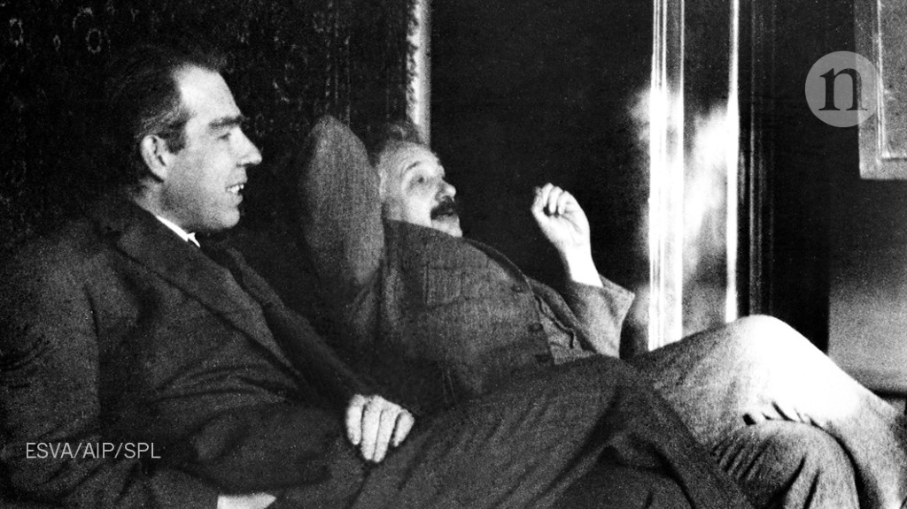

Slide 5
Beloved, do not be surprised at the fiery trial when it comes upon you to test you, as though something strange were happening to you. But rejoice insofar as you share Christ’s sufferings, that you may also rejoice and be glad when his glory is revealed.

Slide 6
Therefore, since Christ suffered in his body, arm yourselves also with the same attitude, because he who has suffered in his body is done with sin

Slide 7
Let us fix our eyes on Jesus, the author and perfecter of our faith, who for the joy set before him endured the cross, scorning its shame, and sat down at the right hand of the throne of God. Consider him who endured such opposition from sinful men, so that you will not grow weary and lose heart. Hebrews 12:2

Slide 8
If you are insulted for the name of Christ, you are blessed, because the Spirit of glory and of God rests upon you.

Slide 9
The power to live outside of the tyranny of the opinions of others is rooted in our identity in Christ.

Slide 10
But let none of you suffer as a murderer or a thief or an evildoer or as a meddler.

Slide 11
Yet if anyone suffers as a Christian, let him not be ashamed, but let him glorify God in that name.

Slide 12
If you falter in times of trouble, how small is your strength! Prov 24:10

Slide 13
TRAIN!
GROW!
PRACTICE!

Slide 14
For it is time for judgment to begin at the household of God; and if it begins with us, what will be the outcome for those who do not obey the gospel of God? And “If the righteous is scarcely saved, what will become of the ungodly and the sinner?”

Slide 15
Two Kinds of “Judgment”

Slide 16
Godly sorrow brings repentance that leads to salvation and leaves no regret, but worldly sorrow brings death. 2 Corinthians 7:10

Slide 17
Therefore, let those who suffer according to God’s will entrust their souls to a faithful Creator while doing good.

Slide 18
Jesus called out with a loud voice, “Father, into your hands I commit my spirit.” When he had said this, he breathed his last. Luke 23:46

Slide 19
Avoid
Deny

Slide 20
Therefore, let those who suffer according to God’s will entrust their souls to a faithful Creator while doing good.

