Slide 1
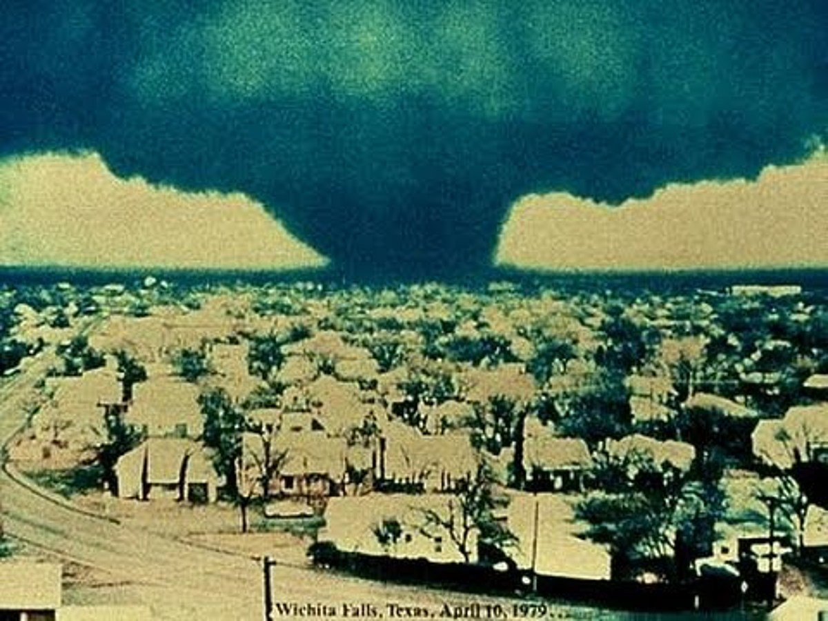
Terrible Tuesday

Slide 2
In the Psalms you find a real divine being listening to the complaints of his people, responding to their cries, giving instruction, demonstrating his power and justice, and being present with His people.

Slide 3
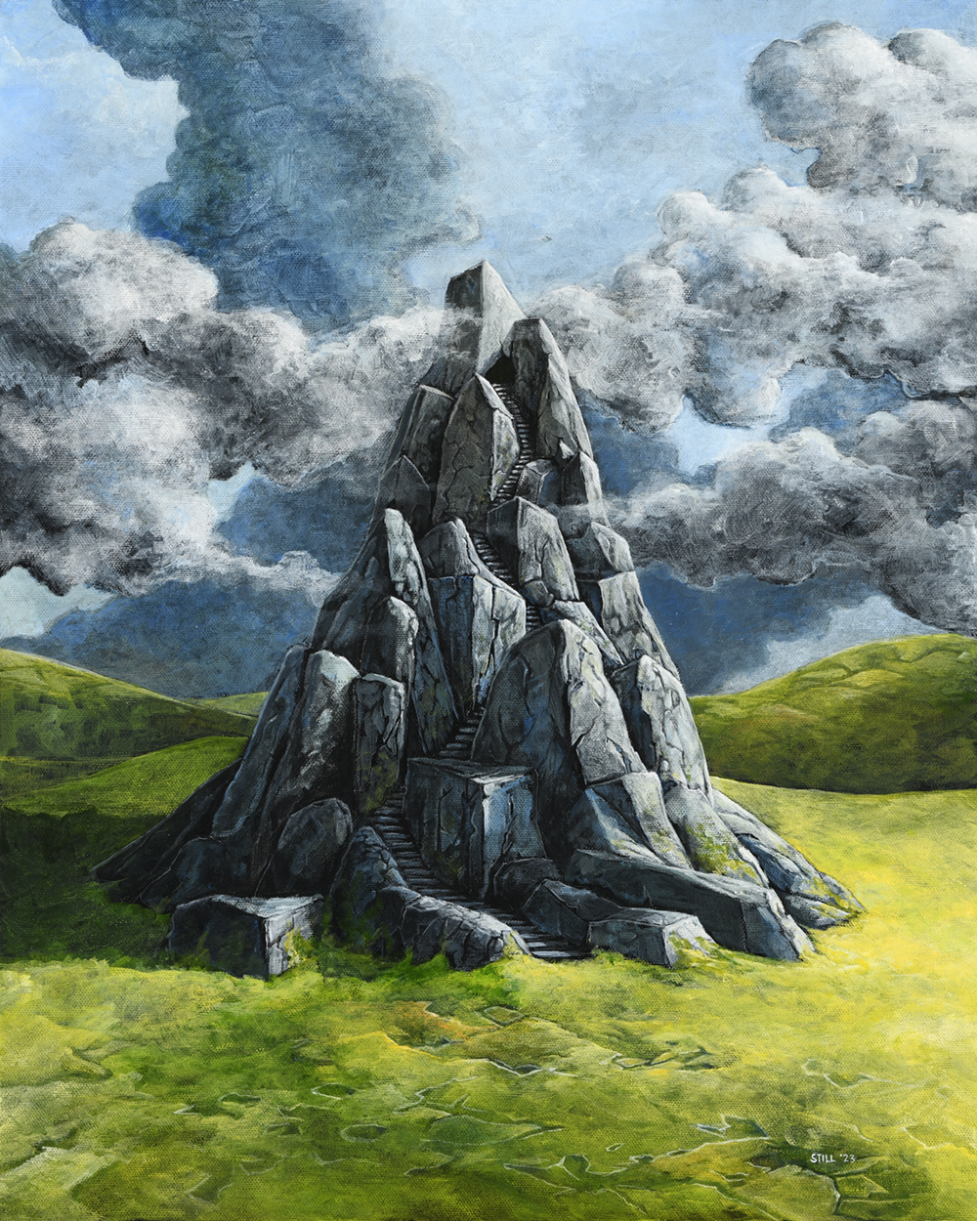

Slide 4
1 I am at rest in God alone; my salvation comes from him. 2 He alone is my rock and my salvation, my stronghold; I will never be shaken.
Psalm 62

Slide 5
3 How long will you threaten a man? Will all of you attack as if he were a leaning wall or a tottering fence? 4 They only plan to bring him down from his high position. They take pleasure in lying; they bless with their mouths, but they curse inwardly
Psalm 62

Slide 6
5 Rest in God alone, my soul, for my hope comes from him. 6 He alone is my rock and my salvation, my stronghold; I will not be shaken. 7 My salvation and glory depend on God, my strong rock. My refuge is in God. 8 Trust in him at all times, you people; pour out your hearts before him. God is our refuge.
Psalm 62

Slide 7
5 Rest in God alone, my soul, for my hope comes from him. 6 He alone is my rock and my salvation, my stronghold; I will not be shaken. 7 My salvation and glory depend on God, my strong rock. My refuge is in God. 8 Trust in him at all times, you people; pour out your hearts before him. God is our refuge.
Psalm 62

Slide 8
Sometimes the right question is not a HOW question, it is a WHO question.

Slide 9
9 Common people are only a vapor; important people, an illusion. Together on a scale, they weigh less than a vapor. 10 Place no trust in oppression or false hope in robbery. If wealth increases, don’t set your heart on it.
Psalm 62

Slide 10
11 God has spoken once; I have heard this twice: strength belongs to God, 12 and faithful love belongs to you, Lord. For you repay each according to his works.
Psalm 62

Slide 11
Strength Belongs to God

Slide 12
Faithful Love Belongs to God

Slide 13
Hesed is defined as an ACT of promise keeping loyalty that is MOTIVATED by deep personal care.

Slide 14
Rest …. work? The right question is not a HOW question, it is a WHO question.
Psalm 62

Slide 15
Talk to your soul Trust Him Pour out your heart to Him
Psalm 62

Slide 16
Psalm 119:57 The Lord is my portion.

