Slide 1
Values are set through -Communication -Demonstration -Celebration

Slide 2
Our great privilege & Our great responsibility

Slide 3
It is about us, but it is for them.

Slide 4
Biblical baptism is immersion after conversion. “They must choose for themselves someday.”

Slide 5
Making Marking Maturing A Commitment

Slide 6
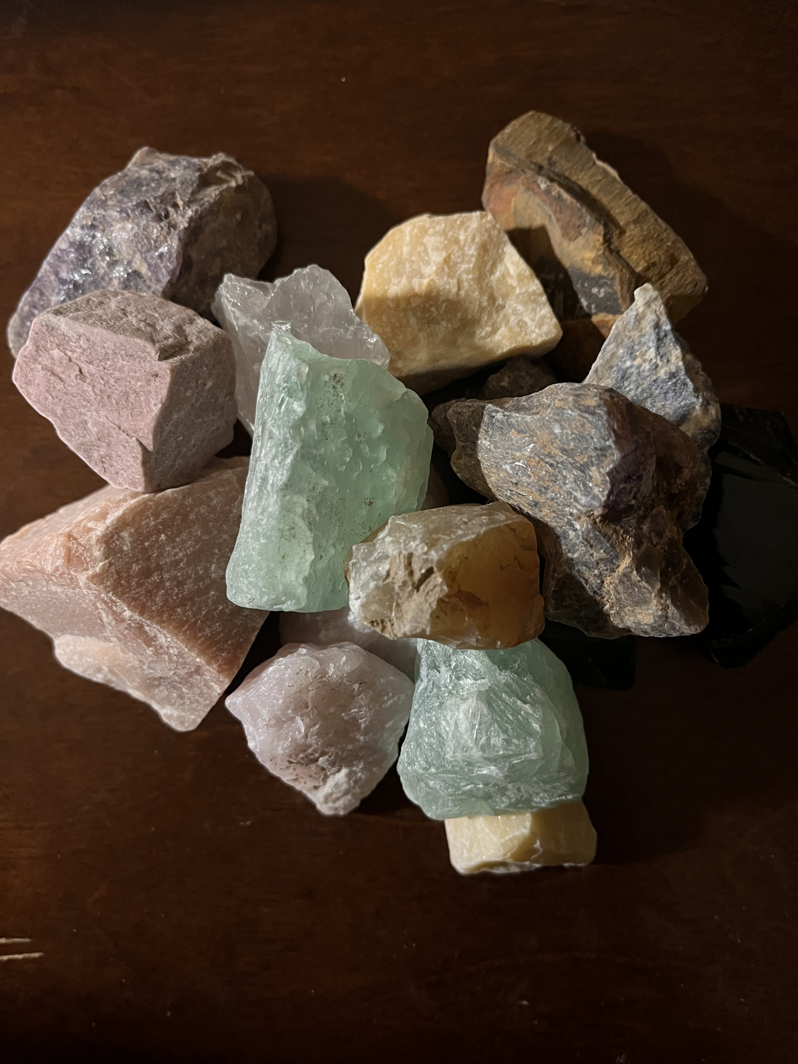
Skill
Faithfulness
Challenge

Slide 7
Joshua 24 1. He is Lord 2. Throw away idols 3. Live decided not deciding

Slide 8
Passion & Pace Passion=the big “WHY”? Pace=the small “what”?

Slide 9
Let us not become weary in doing good, for at the proper time we will reap a harvest if we do not give up. Therefore, as we have opportunity, let us do good to all people, especially to those who belong to the family of believers. Galatians 6:9,10

