Slide 2
Pervasive Pernicious Not true

Slide 4
Concerning this salvation, the prophets, who spoke of the grace that was to come to you, searched intently and with the greatest care, trying to find out the time and circumstances to which the Spirit of Christ in them was pointing when he predicted the sufferings of Christ and the glories that would follow. 1 Peter 1:10-11

Slide 5
He(Jesus) was chosen before the creation of the world, but was revealed in these last times for your sake. 1 Peter 1:20

Slide 6
All men are like grass, and all their glory is like the flowers of the field; the grass withers and the flowers fall, but the word of the Lord stands forever.” And this is the word that was preached to you. 1 Peter 1:24-25

Slide 7
We did not follow cleverly invented stories when we told you about the power and coming of our Lord Jesus Christ, but we were eyewitnesses of his majesty....Above all, you must understand that no prophecy of Scripture came about by the prophet’s own interpretation. For prophecy never had its origin in the will of man, but men spoke from God as they were carried along by the Holy Spirit. 2 Peter 1:16, 20-21

Slide 8
Bear in mind that our Lord’s patience means salvation, just as our dear brother Paul also wrote you with the wisdom that God gave him. He writes the same way in all his letters, speaking in them of these matters. His letters contain some things that are hard to understand, which ignorant and unstable people distort, as they do the other Scriptures, to their own destruction. 2 Peter 3:15,16

Slide 9
This is a Biblical proclamation on Biblical inspiration

Slide 10
Appeal to Authority

Slide 11
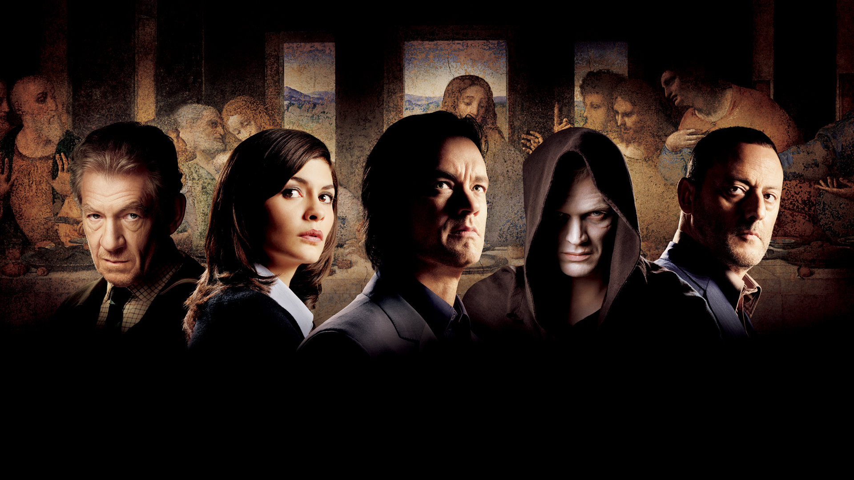

Slide 12
Inspiration Dissemination Recognition Translation Transformation.

Slide 13
1. Inspiration: "All Scripture is God-breathed and is useful for teaching, rebuking, correcting and training in righteousness." 2 Tim. 3:16

Slide 14
2. Dissemination “They valued the text over their lives.”

Slide 15
3. Recognition “God determined; the Church discovered.” Your word, O Lord, is eternal; it stands firm in the heavens. Ps. 119:89

Slide 16
4. Translation “If God spare my life, before many years, I will ensure that a boy working in the fields will know more of the Scripture than you do.” William Tyndale

Slide 17
5. Transformation “I am not ashamed of the gospel, because it is the power of God for the salvation of everyone who believes.” Romans 1:16

Slide 18
“In those days there was no king in Israel. Everyone did what was right in his own eyes.” Judges 17:6

Slide 19
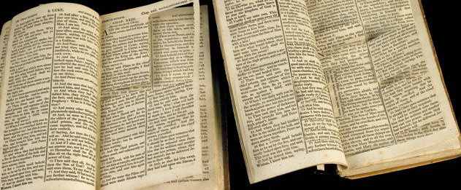

Slide 20
“No thanks, I’m good!”

